Slide 1
New Ideas in Teaching and Learning
An Inside Higher Ed webcast
Wednesday, March 14, 2018, at 2 p.m.

Slide 2
Presenters
Scott Jaschik, editor, Inside Higher Ed, scott.jaschik@insidehighered.com
Doug Lederman, editor, Inside Higher Ed, doug.lederman@insidehighered.com

Slide 3
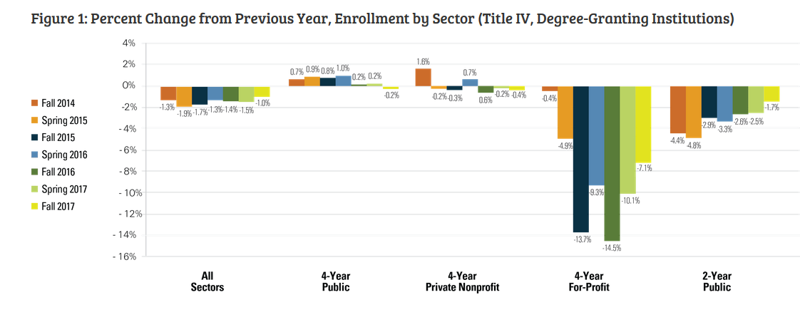
The Imperative: I
--National Student Clearinghouse

Slide 4
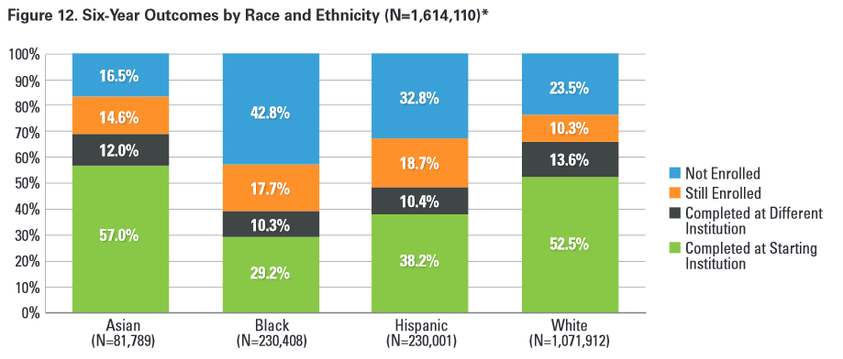
The Imperative: II
--National Student Clearinghouse

Slide 5
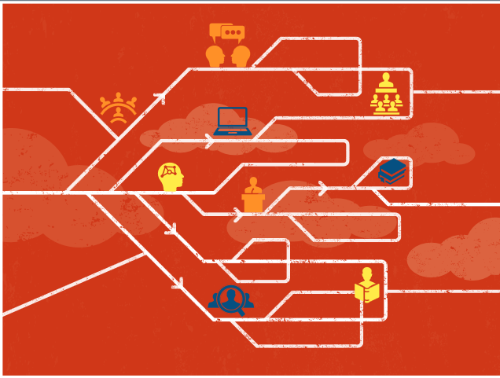
A Systemic Approach
Ideas from major study on teaching and learning by American Academy of Arts and Sciences:
--For campus leaders
--For department leaders
--For disciplinary associations
--For government

Slide 6
The Ideas That Follow
Different institutions, different strategies
Experiments – successes and ideas about which the jury is still out
Big budgets sometimes, but not always
Changing student and faculty behavior
Face-to-face and online
Strong faculty role

Slide 7
Centrality of Data

Slide 8
‘All for One’
The importance of one-to-one communication
Learning students’ names
Regular conferences

Slide 9
Faculty-Student Interaction (National Data)

Slide 10
Centralizing Academic Help

Slide 11
Changing Science Instruction at Research Universities

Slide 12
Evolving Teaching and Learning Centers

Slide 13
Using the Summer to Finish in 4

Slide 14
Rejecting M-W-F Routine

Slide 15
Getting Students to Obtain and Use Course Materials
The problem of cost
Range of new models

Slide 16
Course Materials: Relevance Matters
Ability with digital to mix and match
Linking reading assignments to what goes on in class

Slide 17
Sentiment Analysis

Slide 18
The Confusion Button

Slide 19
The (Non-)Inclusive Classroom
Face-to-face
Online

Slide 20
The Great Assessment Debate

Slide 21
Training and Incentives
Teaching Ph.D. candidates to teach
Rewarding faculty members who teach (even at research institutions)

Slide 22
Your Questions
Q&A
Ideas for future coverage

Slide 23
With Thanks …

