Slide 1
Producing job-ready graduates in a pandemic-impacted job market
June 24, 2020
Notes:
6/24 IHE Webinar - Run of Show & Questions

Slide 2
Agenda
1 | Opening remarks
2 | How innovative universities prepare students for the rapidly changing workplace
3 | How Coursera partners with universities to integrate online learning
4 | Speaker discussion
5 | Audience Q&A
Notes:
Run of Show
Todd’s opening remarking & speaker intros (5 min)
Poll Question #1
Gary’s slides (20 min)
Poll Question #2
Betty’s slides (15 min)
Speaker Discussion (10 min)
Audience Q&A (10 min)
Wrap-Up

Slide 3
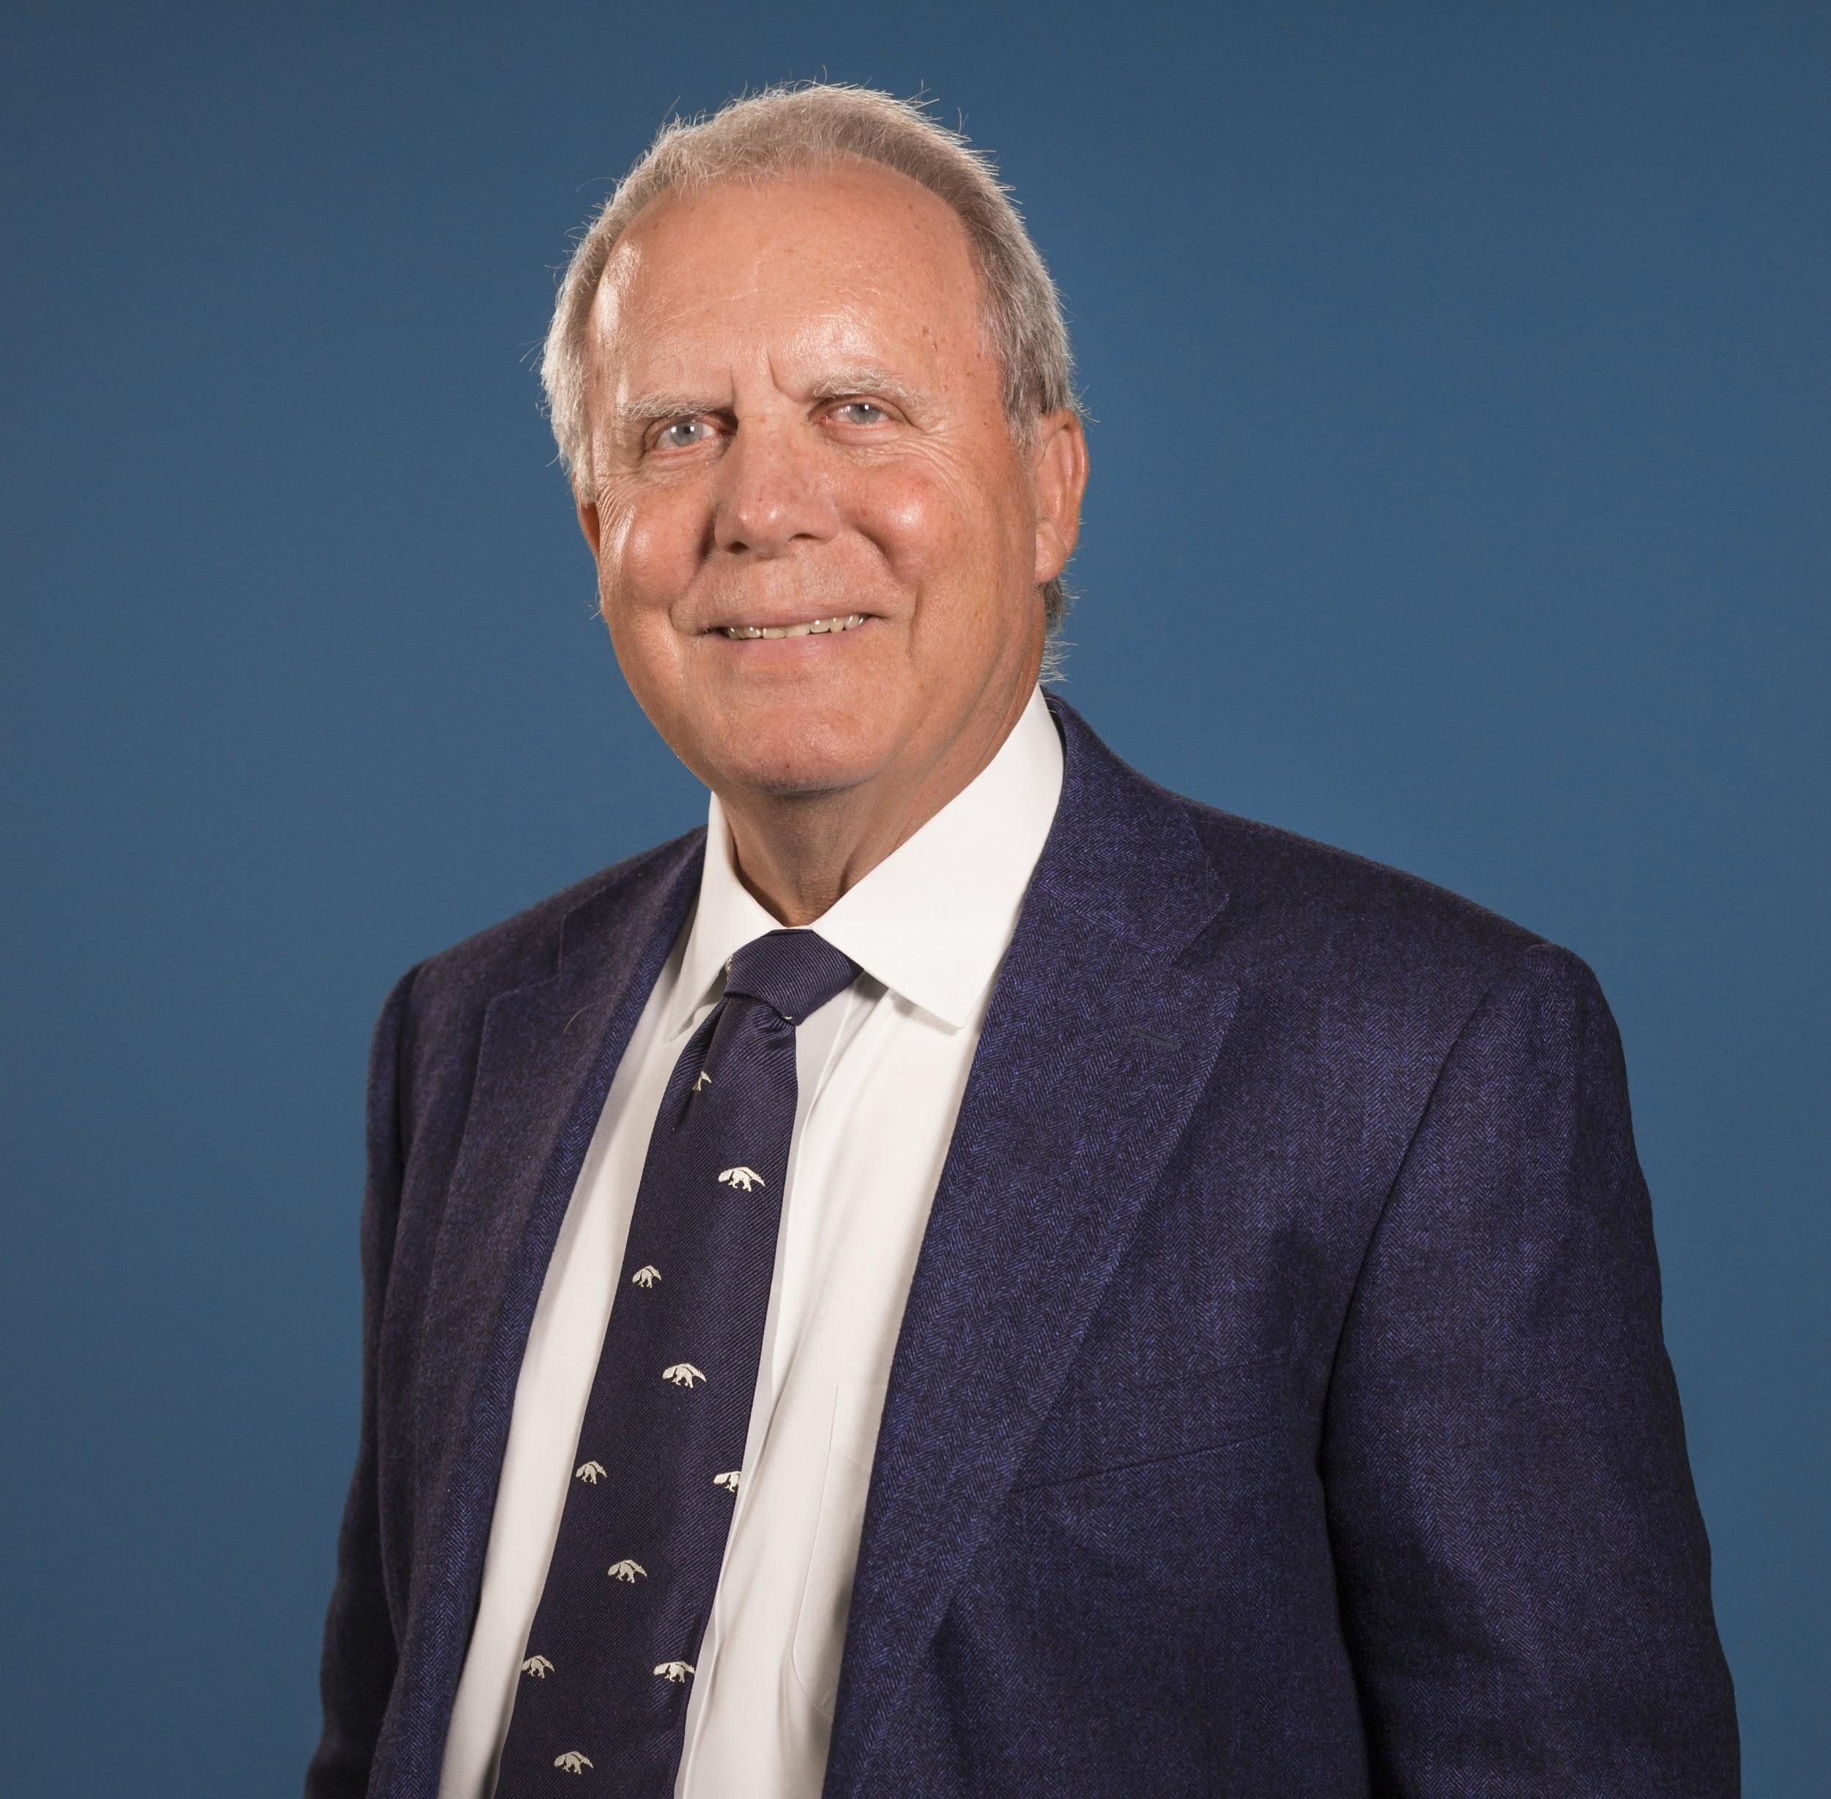
Your presenters today
Gary W. Matkin Ph.D
Dean, Division of Continuing Education
Vice Provost, Division of Career Pathways
University of California, Irvine
Betty Vandenbosch, Ph.D
Chief Content Officer
Coursera
Todd Bloom
Managing Director WGU Labs
Notes:
Gary W. Matkin, Ph.D. is Dean of Continuing Education and Vice Provost for Career Pathways at the University of California, Irvine. The Division of Continuing Education (DCE) offers about 3000 courses per year and attracts about 40,0000 enrollments. It has an annual self-supporting Budget of $40 million. The Division of Career Pathways (DCP) serves UCI’s 36,000 matriculated students as they seek to identify, prepare for, and enter meaningful careers. DCP is expanding its services to continuing education students and alumni as well. DCE is a major contributor to the open education movement and Gary is known for his efforts to support the 60-Year Curriculum and Alternative Digital Credentialing. Gary holds a Bachelor of Science degree from the University of San Francisco, and an MBA and Ph.D. from UC Berkeley and he is a certified public accountant.
Betty Vandenbosch, Ph.D oversees Coursera’s content and credential strategy and partner relationships. Before joining Coursera, Betty was chancellor of Purdue University Global, an institution resulting from Purdue University’s 2018 acquisition of Kaplan University. At Purdue, Betty oversaw academics for more than 32,000 students -- most of whom earned their degrees online. Before that, Betty held a number of leadership positions at Kaplan University and served as associate dean and associate professor at the Weatherhead School of Management at Case Western Reserve University. She earned her Ph.D. in Management Information Systems and MBA from Western University in Ontario, Canada.

Slide 4
Poll Question
Notes:
Poll 1 (slide #4)
How is your university helping students prepare for employment in the pandemic-impacted economy? (Select all that apply)
Enhancing career services
Alternative credentials
Job certificate programs
Distribution partnerships
Curriculum partnerships
Other

Slide 5
How Innovative Universities Prepare Students for the Rapidly Changing Workplace
Gary W. Matkin, Ph.D.
Dean, Continuing Education
Vice Provost, Career Pathways
University of California, Irvine

Slide 6
The Changing University Continuing Education Marketplace
Increased competition
Higher cost of development and delivery
Higher production and pedagogical levels
High cost, more sophisticated marketing costs

Slide 7
Five Innovations that Support Preparing Students for the Workforce
Adopt and implement a 60-Year Curriculum (60YC)
Reposition Career Services
Increase reach of Career Services through technology
Acquire strategic partnerships including open education provisions
Adopt Alternative Digital Credentialing (ADC)

Slide 8
The 60 Year Curriculum
Notes:
This presentation is focused on going behind the rhetoric surrounding the 60YC and its relevance and importance to the very practical aspects of what universities can actually do to advance the 60YC. These activities fall into two groups: 1) What can be done for matriculated students and 2) what can be done for university graduates.

Slide 9
What is the 60-Year Curriculum?
❶ Students Life- Long Learning
❷ Universities 60-Year Curriculum
Notes:
The need for life-long learning has been clear for a long time. And while it is ever more important in a fast changing world, the concept has been used broadly to cover both learners and institutions. In fact, life-long learning is an individual responsibility and the university is responsible for providing and creating access to the 60-year curriculum. Life-long learning begins after graduation from a formal degree program.
In this presentation we will make the case that the 60-year curriculum should be embedded into the experience of matriculated graduate and undergraduate students and at the same time, universities need to continue their teaching relationships with students after they graduate.
In doing that the result of learning outcomes is better for degree seekers. Those students who gain a focus on what they will do after graduation, if that focus occurs early enough, results in better academic outcomes for students—they graduate earlier, have higher GPSs, and are more satisfied with their education after graduation.

Slide 10
The 60 Year Curriculum (60YC): Setting the Context
Starts in freshman year
Extends for a lifetime
Fulfills the University’s role and obligation for lifelong learning
Notes:
The 60YC is associated with universities and thus starts in the freshman year. But its intention is to serve students after they graduate by providing formal educational experiences to help them through life transitions, from school to work, job to job, career to career, and work to retirement.

Slide 11
Why Universities Should Embrace the 60YC
Fulfills accountability metrics
Represents “learner centeredness”
Improves educational outcomes
Sound basis for continued contact with graduates (fund raising)
Improves institutional competitive position
Notes:
Universities are being driven toward the 60YC by a number of reasons. First, universities are increasingly being held accountable for what happens to students after they graduate. The sharp increase in tuition and the incurring of significant student debt has intensified this accountability over the last decade. Further evidence of the importance of the 60YC concept is the response of higher education service organizations and university ranking systems that are based on post-graduation employment data. As never before, a college education is looked upon as an investment and investments are characterized by the need for a return on investment. In response, most regional accrediting bodies are requiring universities to develop clear desired learning outcomes for each degree program they offer. Many such desired outcomes relate to the continuation of education (such as entry to graduate school) or career placement.
Second, the adoption of the 60YC theme fosters learner-centeredness. Surveys clearly indicate that both entering freshmen and their parents overwhelmingly see a college education as a pathway to meaningful careers and employment. A truly learner-centered institution has to take this primary motivation into account in its pedagogy and its services. Introducing students to real world experiences, using case studies and requiring group work are examples of how pedagogy might be adjusted toward the 60YC goals. Providing jobs and internships, as well as other workplace oriented co-curricular activities is another example of what universities can do to fulfill this learner centered demand.
Third, the 60YC theme will help students achieve better academic outcomes. A very large body of research clearly indicates that students with a strong intentionality toward what they will do after graduation results in better grades, less time to degree, reduced stress, and greater satisfaction after graduation (Gallup-Purdue, 2016 and Hull-Banks, et-al, 2016). The earlier this intentionality is defined, the greater the benefit. Students are aided in choosing not only the appropriate major, but also individual classes and co-curricular activities, including jobs and internships. There is very strong evidence that the 60YC is a powerful enhancer of academic quality.
Fourth, the 60YC provides the framework for a natural lifelong association between the institution, its graduates, and graduates of other universities that live in proximity to the campus. These relationships can manifest in financial and political support for the institution. The 60YC is the background for the “friend-raising” side of the development process.
Fifth, universities need to adopt some version of the 60YC to remain competitive. Some universities are already adopting the 60YC as major initiatives. For instance, Georgia Tech recently (Bras, 2018) issued a report titled “Deliberate Innovation, Lifelong Education.” It positions Georgia Tech’s commitment to lifetime education and offers specific examples of what may be done, including allowing for flexible academic calendars, awarding new kinds of credentials, allowing learners to interact with Georgia Tech faculty, and providing an advising and coaching network for life.

Slide 12
The 60YC Curriculum: What Universities Should Do
Adjust pedagogy to embrace post-graduate career skills
Articulate degree courses with CE certificate programs
Provide information about careers as they relate to majors
Offer “life management” courses to Freshman
Develop instructor pools from relevant careers
Offer career success courses and programs

Slide 13
UCI Life Transitions 60YC
Retire
Be a Successful Student
Upgrade or Change Careers
Find and Enter a Career
Be Digitally Competent
Be Effective in the Workplace

Slide 14
Retire
Be a Successful Student
Upgrade or Change Careers
Find and Enter a Career
Be Digitally Competent
Be Effective in the Workplace

Slide 15
Be Effective in the Workplace
Oral and Written Communications
Critical Thinking, Design Making, and Problem Solving
Basic Technologies
Career Enhancement
Global and Intercultural Influence
Project Management and Leadership
Creativity
Team and Collaboration
Developing a Work Life/Balance

Slide 16
Be Effective in the Workplace
Oral and Written Communications
Communicating data
Writing effective emails and memos
Business writing
Public speaking fundamentals
Data Visualization
Public speaking fundamentals
Writing proposals
Presentation design
How to turn information overload into a clear message
Storytelling techniques for business
Fundamental techniques for influencing others

Slide 17
Be Effective in the Workplace
Oral and Written Communications
Business writing
Effective Business Writing for Workplace Professionals (full course)
Effective Business Writing for Workplace Professionals (Consortium short course)
High-Impact Business Writing (via Coursera)
How to Communicate Effectively at Work (Consortium short course)
Modern Business Writing (full course)

Slide 18
Retire
Be a Successful Student
Upgrade or Change Careers
Find and Enter a Career
Be Digitally Competent
Be Effective in the Workplace

Slide 19
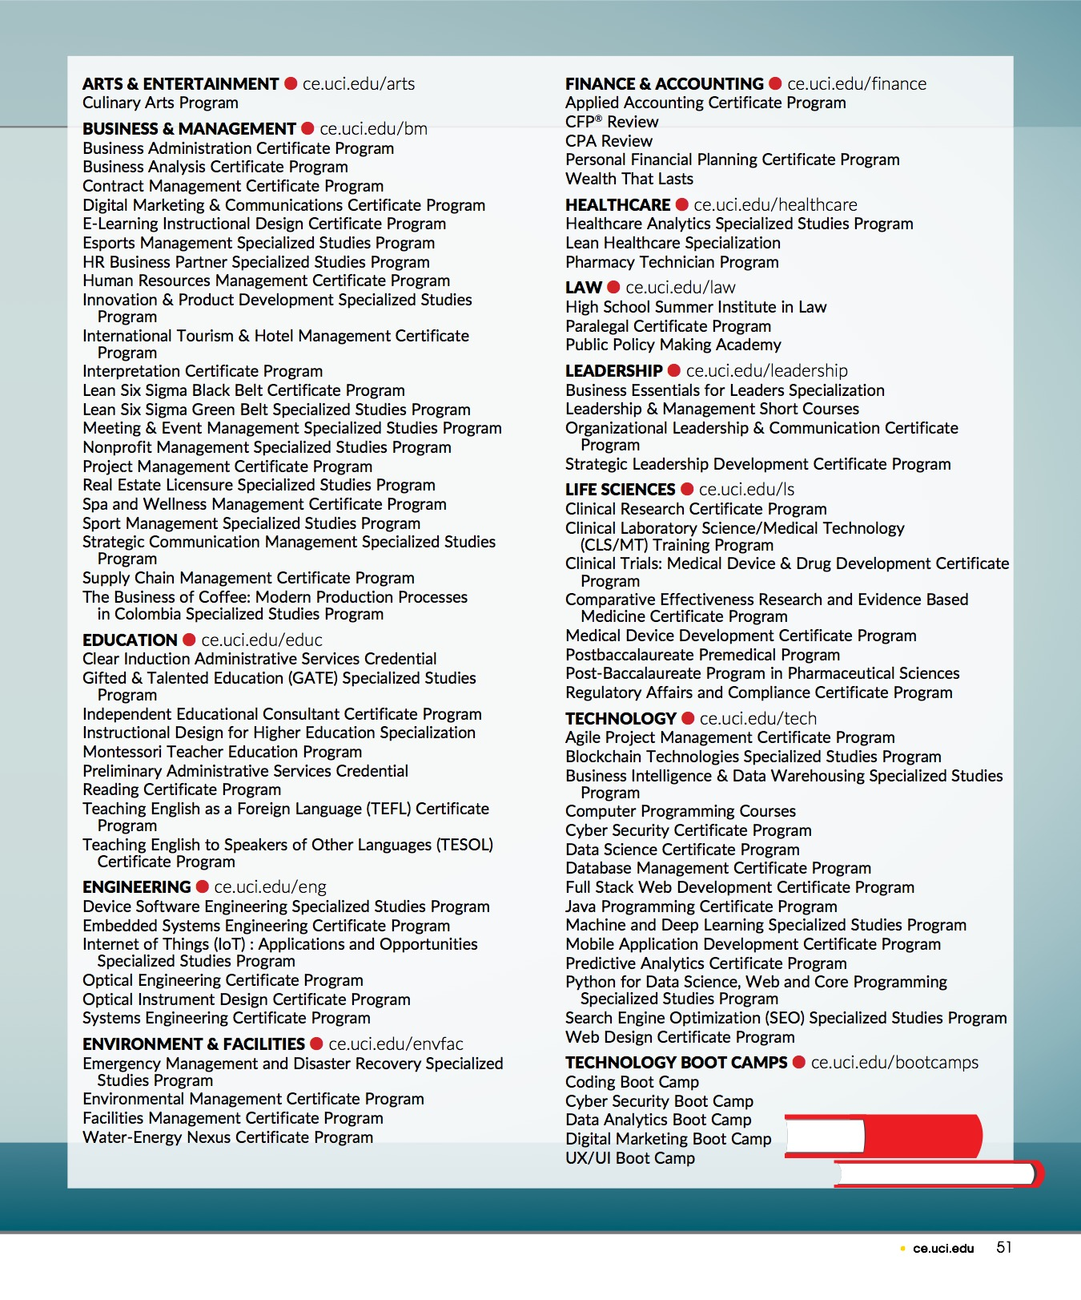
Upgrade or Change Careers
Software development
Computer programming
Digital security and privacy
Digital design

Slide 20
Reposition Career Services

Slide 21
The Natural Partnership
Continuing Education
Career Services
Alumni Association

Slide 22
Increase the Reach of Career Services through Technology

Slide 23
UCI’s Three Talent Pools
STUDENTS
36,000
Entry Level
ALUMNI
200,000
CE GRADS
35,000
Experienced
Notes:
To provide access to the talent in these three talent pools through a coordinated mechanism would be the first in the nation.

Slide 24
The Three Tiers of Career Services for CE Students
Website information
Technology-based services
Customized treatments

Slide 25
The Career Services
Handshake
PeopleGrove
Career Spots
Big Interview
GoinGlobal
Career Fairs Plus
Versatile PhD
Imagine PhD
VMock
EMSI Career Coach
Notes:
We think a key to organizing the marketplace is the use of technology. And at DCP, we have a premier portfolio of technical solutions.
Many units offer career services or advice. We’d like capture the best ideas while equipping our partners with common tools and resources to carry out career services in a more coordinated way.
We also want to create career communities for students. This means identifying groups of academic disciplines, industries, or student populations (such as international students) and then designing customized programming and resources for them. It also means brining them to together in forums with employers and alumni to learn from their peers as well as industry experts. Speaks to students desires for customized services.
Internships and jobs are seen as basic qualifications for most roles requiring a college degree. So to do our job, we need to provide every students the opportunity to access one or more authentic workplace activities before they graduate.
Beyond the common website, we will take new look at how to leverage technology, including online courses, to increase our capacity to deliver services. One way we have already enhanced our online services was through the update from Zotlink to Handshake this fall. I checked today and nearly 18,000 students are active users of Handshake.
Our last item here is the creation of defined pathways for students to put them and UCI in the best light as they pursue their goals. I’m going to talk about the pathways in a bit more detail next.
Road Trip Nation: curates videos for students based on their interests. A great career conversation starter!
Career Spots http://career.uci.edu/careerspots/ Career Spots is an online library of 90 brief videos covering career readiness competencies, job searching, and internships.
Big Interview http://career.uci.edu/big-interview/ Big Interview allows students to conduct virtual mock interviews for all experience levels across many industries. Students can access a step-by-step interview Answer Builder for crafting answers to behavioral based interview questions. Students may share their videos with others, including DCP staff and UCI faculty, for feedback.
GoinGlobal http://www.goinglobal.com/ GoinGlobal is an online reference designed for any student interested in international careers. It provides country career guides as well as information about obtaining authorization to work in the U.S.
Vault Guides (provided by UCI Libraries)
Career Fair Plus https://app.careerfairplus.com/uci_ca Career Fair Plus is an app that enhances student career fair navigation by allowing customized searches by major, job or internship, industry, and job function. If employers opt in to the “skip the line” function, they can allow students to set a specific time to meet at the fair.
Versatile PhD http://career.uci.edu/students/graduate/versatile-phd/ Versatile PhD offers first-hand advice about nonacademic careers for STEM PhDs and postdoctoral scholars, including resume and cover letter samples, career autobiographies, and career panel discussions with PhDs successfully employed outside the academy. Versatile PhD provides an online, six-module course entitled “PhD-focused Options for Success Career Exploration.”
Imagine PhD http://career.uci.edu/students/graduate/imaginephd/ Imagine PhD is an online career exploration and planning tool for PhD students and postdoctoral scholars in the humanities and social sciences. It offers a self-assessment that allows users to develop goals and map out next steps for career and professional development success.
VMock (in contract negotiations) https://www.vmock.com/ VMock’s artificial intelligence provides instant and substantive resume reviews. Students upload their resumes and are given a score based on algorithms derived from thousands of resumes and job descriptions. Students can incorporate the feedback and re-upload resumes to raise their scores.
EMSI Career Coach (in contract negotiations) https://www.economicmodeling.com/student-success/ EMSI Career Coach draws on labor market research to help users identify how well their interests align with careers, to take a deep dive into career path information, and to instantly access and apply for all currently available positions that match their interests.
ALSO:
The Anteater Network (provided by the UCI Alumni Association) https://antnet.uci.edu/ Powered by the vendor PeopleGrove, the Anteater Network is an online space where alumni and students can connect for professional mentoring.

Slide 26
Acquire Strategic Partnerships
Distribution partnerships
Curriculum partners
Service partners

Slide 27
Distribution Partners: UCI Coursera Course Statistics: January 2013-Present
Total Visitors | 19.4 million
Enrolled in Course | 4.2 million
Started Course | 2.7 million
Completed Course | 500,000
AVERAGE RATING (5PT SCALE) | 4.6

Slide 28
UCI/Coursera Top Six Courses
COURSE NAME | VISITORS (in millions)
Grammar and Punctuation | 1.93
Project Management-The Basics | 1.88
Work Smarter, Not Harder | 1.5
Power of Macroeconomics | 0.7
Finance of Non-Financial Professionals | 0.7
The Power of Microeconomics | 0.6

Slide 29
UCI CE YouTube Course Views
2018/2019 | 3,739,629
2019/2020 (est.) | 4,014,000

Slide 30
Curriculum Partners
Trilogy-Boot Camps
Program Sharing Network
UC Davis
UC Riverside
Athabasca

Slide 31
Adopt Alternative Digital Credentialing

Slide 32
Certificate Programs
Industry Credential
Nano-Credentials
The Alternative Credential Ecosystem
Workplace Training
Micro-Credentials
MOOCs
Boot Camps
Notes:
To initiate the issuance of an ADC, the issuing organization or institution posts the ADC to a repository that is secure and unhackable. At the same time, the issuing organization or institution stores this posting to its own record system.
After posting to the repository, the recipient may then post the ADC to any digital repository including to a resume, to LinkedIn and other social media sites, to employers and potential employers, and even to friends.

Slide 33
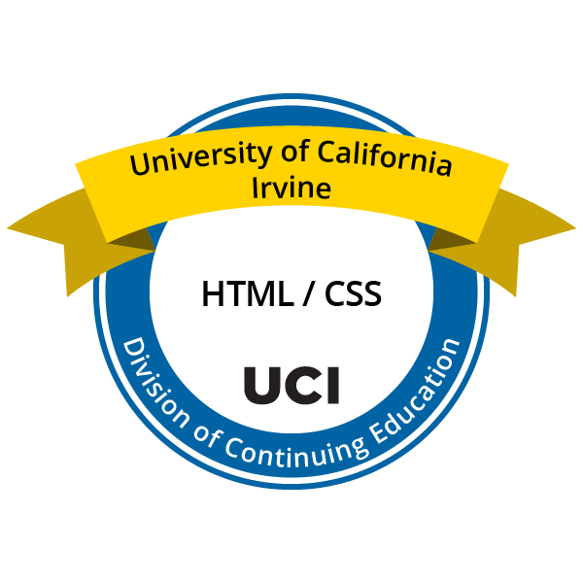
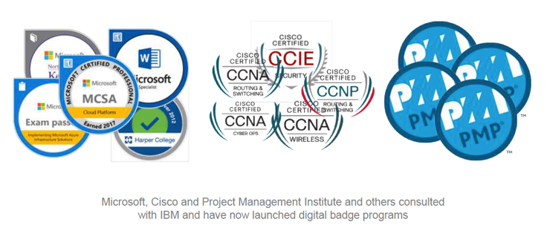
The Concept of ADCs (Badges)
Notes:
Here are some examples from both higher education and the corporate world of the icons used to signify that the recipient of the ADC has achieved a specific competency in a defined topic.

Slide 34
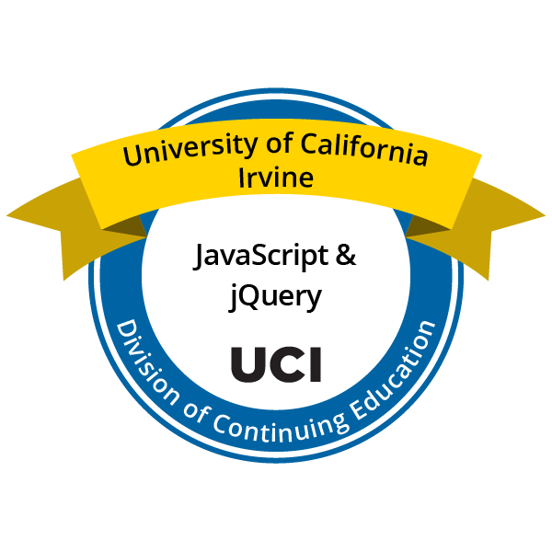
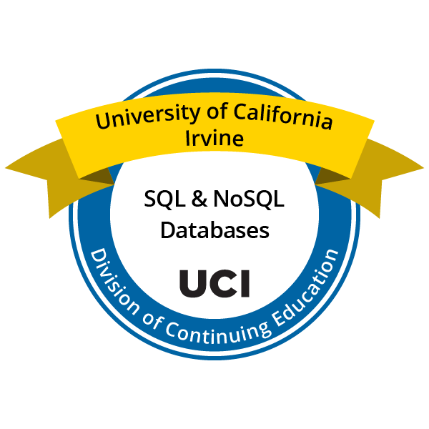
Examples of Competency-Based ADCs
Notes:
Here are examples of ADCs issued by UCI. Note that it contains three simple components:
Name of issuing institution institution
Unit or division issuing institution responsible for ADC (UCI Division of Continuing Education)
The competency represented by the ADC (HTML/CSS)

Slide 35
ADC Pathways
Secure, Unhackable Repository
Permanent Record
Issuing
Organization
ADC Recipient
LinkedIn
Social Media
Potential
Employers
Friends
Digital Resume
Notes:
To initiate the issuance of an ADC, the issuing organization or institution posts the ADC to a repository that is secure and unhackable. At the same time, the issuing organization or institution stores this posting to its own record system.
After posting to the repository, the recipient may then post the ADC to any digital repository including to a resume, to LinkedIn and other social media sites, to employers and potential employers, and even to friends.

Slide 36
Rationale for Institutional Adoption of ADCs
Already widely used
Certify valuable, more granular, non-degree-level skills and abilities
Makes universities accountable
Young adults demand shorter, relevant education
ADCs are a natural outcome of open education
Companies use digital searches to hire candidates
The ADC ecosystem is developing
Employer acceptance is increasing
Notes:
Evidence that ADCs are indeed a higher education imperative is rapidly increasing. ADCs are already widely issued, especially by non-higher education institutions and several governments are adopting ADCs as central to higher education systems (New Zealand, Malta, Australia). As already indicated, traditional transcripts are less and less relevant to workforce demands for competency certification. ADCs fill in an important gap between learning and work relevant skill verification. The adoption of an ADC system will push universities toward greater alignment with the demands of both students and local economies, making universities more accountable for what they produce. Young adults are demanding shorter, relevant education that they can put to immediate use. The huge supply of open education available in the world represents a large opportunity for certification of competencies. Hiring practices of companies increasingly depend on digital searches for job candidates. ADCs make those competencies discoverable. ADCs are forming a system of standards and support, and employer acceptance of ADCs is increasing.

Slide 37
Implementation: Critical Decisions
Criteria for issuance
Icon design
Metadata content
Platform selection
Administration – issuing unit(s)
Recordkeeping
Oversight
Notes:
Any implementation plan should begin with the making of several decisions, listed here. The criteria for issuance has already been discussed. Icon design may seem out of place in the early decision making process, but it turns out to be important because it has to reflect the structure of the offering. Metadata content has already been discussed and is listed in the following slide again. Ultimately, universities have to select a particular platform offer the issuance and record keeping necessary for the service.

Slide 38
ICDE Report: The Present and Future of Alternative Digital Credentials
https://www.icde.org/knowledge-hub/2019/4/10/the-present-and-future-of-alternative-digital-credentials

Slide 39
Thank You

Slide 40
How Coursera partners with universities to integrate online learning
Betty Vandenbosch, Ph.D
Chief Content Officer
Coursera

Slide 41
Poll Question
Notes:
What forms of stackable credentials does your university allow to help individuals progress on a career path? (select all that apply)
Associate degrees
Industry certificates
Technical certificates
Credits from other institutions
MOOC completion
Uncertain

Slide 42
ACADEMY
DATA SCIENCE
ACADEMY
How Coursera prepares learners for in-demand roles
Data Scientist
Machine Learning Engineer
Data Engineer
Data Analyst
Roles
Data Science & Analytics Teams
Product & Engineering Teams
Marketing & Operations Teams
Managers & Executives
RESKILL EXISTING TALENT FOR IN-DEMAND ROLES
UPSKILL TEAMS CONTINUOUSLY
Functions
DRIVE LITERACY
Python-First Data Scientist
Data-Driven Product Mgr
Data-Driven Marketer
Data-Driven Leader
Everyone
Data Literacy for Everyone
*Pictured here are a subset of the skill profiles available in the DSA
Data-Savvy Professional
Notes:
At Coursera, we have developed Academies because we feel so strongly that we need to prepare people at different levels and their learning has to stack.
For ex., everyone in every organization needs some understanding of data.
The bottom level is what’s required for everyone.
Then there are functional roles, people in different parts of the organization that need different skills because of their functional expertise. But they all need some data science.
Analytics, product analytics, marketing, managers, all need data science but at different levels. The quality of the work they do is different based on where they are in the organization.
There are also specific, high-level roles that are related to data science. For these, we need to reskill people so they can become the pinnacle jobs in Data Science.
What we do at Coursera:
Set an Academy based on a job task analysis.
Then we think about how we can drive literacy, upskills teams, and reskill for specific talent in an enterprise.
We look to our partners to help us fill the content so each one of these areas is covered in our catalog.

Slide 43
Stackable content for blended learning
Degrees
Certificates
Specializations
Courses
Projects
Notes:
This enables our stackable content to lead to many different levels for our learners.
For most learners, what’s most important is that they learn the skill, and that they can tell other people they learned the skill.
At Coursera, if you take the test so to speak, you can share the outcome (the fact that you succeeded), with places like LinkedIn.
Some of these are higher quality than others - if someone has a Degree, they took the classes on Coursera but the degree is granted by the university.
Certificates: some are transcriptable, S12ns allow people to learn a specific skills, and projects are hands-on experience to learn a specific tool or skill.
The way that our learners come in to the platform depends on where they start

Slide 44
Stackable content for blended learning
Degrees
Certificates
Specializations
Courses
Projects
Take an open course for free
Notes:
As you can see,

Slide 45
Stackable content for blended learning
Data-driven degree recommendations
Degrees
Certificates
Specializations
Courses
Projects
Notes:
You can say this is an area I really want to do something in - I will take a degree
Depending on what course you take, we can recommend what degree

Slide 46
Stackable content for blended learning
Degrees
Certificates
Specializations
Courses
Sub-degree certificate
Projects
Notes:
Learners can also start by taking a sub-degree certificate if you’re quite sure about the area that they are interested in.
We have a few flavors here - MasterTracks, Professional Certificates (enable learners to get a skillset for a particular career), and university certificates which provide high-touch university content but don’t have transcriptable credit.
A special kind of certificate, Gateway Certificate, is offered to learners who don’t have a university degree to prepare them for their first or their next best job.
So, someone working in retail could come in and do a certificate in Google IT and be ready for an entry level job in IT.

Slide 47
Stackable content for blended learning
Credit-eligible if accepted to degree
Degrees
Certificates
Specializations
Courses
Sub-degree certificate
Projects
Notes:
After certificates, some people will go on to a Master’s Degree

Slide 48
Stackable content for blended learning
Credit-eligible if accepted to degree
Degrees
Certificates
Specializations
Courses
Sub-degree certificate
Projects

Slide 49
Stackable content for blended learning
Degrees
Certificates
Specializations
Courses
Projects

Slide 50
Stackable content for blended learning
Degrees
Certificates
Specializations
Courses
Projects

Slide 51
Stackable content for blended learning
>60% of degree students first enrolled in an open course
Degrees
Certificates
Specializations
Courses
Projects

Slide 52
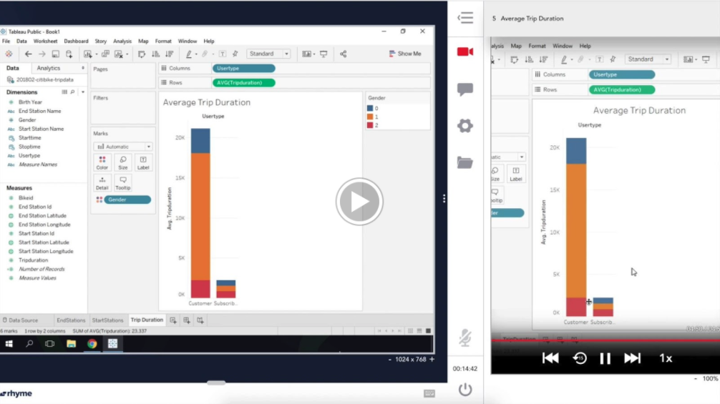
Guided Projects
New type of course that offers students hands-on learning in a short format
Hands on learning
Students start instantly by practicing with a virtual desktop in the cloud
Instructor Led
Easy to follow with instructor led visual elements presented in a split screen interface
Notes:
Talk Track:
What you can do - watch a teacher on the R hand side of the screen, and try to do the same thing on the LHS. So it’s a hands-on experience guided by someone leading the process on the RHS.
We have more than 400,000 students taking guided projects right now, and they just can’t get enough of them.
They run the gamut from Excel spreadsheets, to how to use Google Sheets, to programming in Python.
Many ways to create projects embedded in courses. Guided projects can help students get to where they want to be.
Another ex. - a company wants someone to do something in a certain way, they can create a private project.
--
Coursera brings hands-on learning at scale with Guided Projects. Your students can learn new software applications fast by following along with side-by-side instructions.
The Guided Projects are powered by cloud desktops so no software installations are required.
Students complete instructor-lead tasks and receive virtual feedback as they make progress
We know that within classroom training, applied learning can be up to 45% more effective than theoretical learning alone (Source: The effectiveness of applied learning: an empirical evaluation using role playing in the classroom)
And students without hands-on learning opportunities are 1.5x more likely to fail class (Source: Active learning increases student performance in science, engineering, and mathematics)

Slide 53
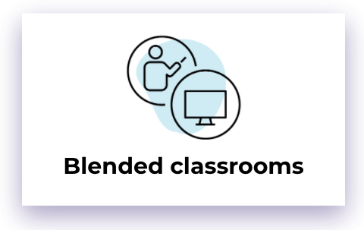
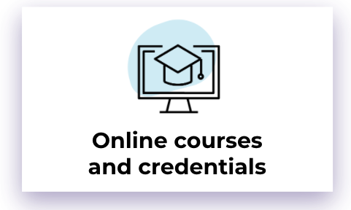
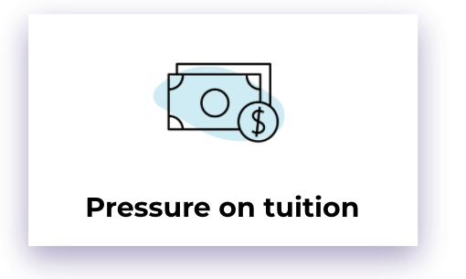
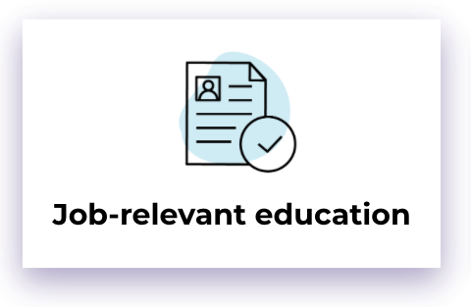
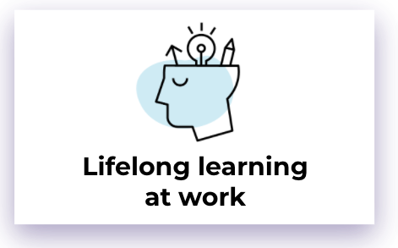
Trends in higher education
53
53
53
Notes:
Talk Track:
There are other trends that drive the way that the world moves forward. First off, we believe that blended classrooms are here to stay. In some ways, this is no different than a flipped classroom. The lecture is done online and the learning is done face to face or live.
Online courses are also here to stay. Most uni’s, esp. In NA, teach in part online and there are many credentials available online.
These two things lead to downward pressure on tuition - this will go down because people don’t want to pay for the college experience, they want to pay for the skills they need.
That leads us to believe: we need job-relevant education, and we want to pull together theory and practice.
Many institutions are already doing this, but to ensure our learners are job-ready, their education needs to be practical as well as theoretical. They need to understand the concepts and applies them.
It’s important for us to keep track of. Also, we believe (60 year curriculum) lifelong learning, will happen at work. People have busy lives, and once they’re in the workforce they need to be able to learn at the office or on the same day they need something.
So we believe enterprises will get much more involved. Since we’re in a recession in North America, and perhaps the world, enterprises might cut education - but given the dire need for specific skills that aren’t available, learning at work is hear to stay.
PREVIOUS talk track:
Blended will become the new norm.
Both students and teachers will be on/off campus.
That means you must have online content, including courses and fully online degrees.
According to a SimpsonScarborough April 2020 survey, 15% of college students who, when given the option to finish their degree online or complete their degree in-person, want to finish online. As of fall 2019, UNESCO estimates there are 220 million students enrolled in higher ed.
That estimate alone suggests 33 million students could elect to finish their degree online.
Every university will build, buy and augment online content.
Data will make learning more personalized + effective.
Once you start online, there is pressure on tuition
People will not want to pay as much if not on campus.
Also, because of unemployment, people will have less to spend.
With unemployment soaring, job-relevant education will be a must.
According to Gallup, only 34% of US college students feel they have the knowledge and skills needed for the workforce
This will become mission-critical.
Students will demand skill-based, hands-on learning that comes university and industry.
Lifelong learning will happen at work.
People are not going to give up their job to continue learning.
According to Society for Human Resource Management’s 2019 data, more than half (56%) of employers offer tuition assistance for employees pursuing degrees.
Since they’re learning at work, they have to learn in smaller chunks.
Projects; Professional Certificates; MasterTrack™ Certificates
According to a Rapid Learning Institute survey, 94% of Learning & Development professionals said that their learners preferred bite-sized learning modules to eLearning courses.

Slide 54
Key dimensions to consider for digital transformation
Catalog
Capacity
Faculty
Technology
Governance
“How many courses and degrees are available online?”
“How rapidly can you create online content and credentials?”
“How much interest, time, & experience does your faculty have teaching online?”
“What connectivity and video capabilities do students and faculty have?”
“How effectively can you anticipate, recognize and respond to emergent conditions?”
CATALOG
CAPACITY
FACULTY
TECHNOLOGY
GOVERNANCE
Notes:
Here’s what we believe universities need to consider when they think about how to move forward with digital transformation in the post-COVID world.
How good are the faculty online?
How good is the technology, and how effective is governance?
All of these things affect how people work in a post-COVID world, coupled with the need that learners are job-ready tells the story of how to think about your instituion and what you need to do to attract and prepare students for the jobs here today and coming tomorrow.

Slide 55
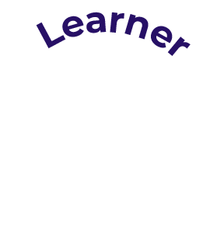
Coursera
global learning ecosystem
60+ million
Registered learners
2,400+
200+
Coursera for Business
Coursera for Government
Coursera for Campus
University & Industry Partners
55
Source: Coursera data, April 2020
Notes:
Talk Track
At Coursera we do this with a global learning ecosystem. We have 63M registered learners, 200+ partners who create content, and 2400 businesses, governments and universities who use our content.
Because we have this 3-sided relationship on our platform, we can help educators share their learning with learners and employers (b2c and b2b).
Our learners get education from the best educators in the world, and in some small ways today, also have connection to employers. Employers can have connection to the learners but also to the educators that they need specifically to meet the needs of their employees and businesses.
6/11/20:
We have insights from our 60M+ learners. The students select courses with a goal in mind, we can help them be confident that these are the right courses and skills to pursue.
By being part of the Coursera ecosystem, you have insights to be confident about the choices you’re making and how you're preparing your students

Slide 56
Coronavirus Response Initiative for campuses
On March 12th, Coursera began offering any college or university impacted by COVID-19 free access to its course catalogue.
coursera.org/coronavirus
Notes:
One way that we and our partners have responded is by providing all universities free access to the Coursera catalog until the end of July.
Students can learn through September. We did this because we recognized that not every university is in a place to go online effectively in the amount of time they had to do so.
The results have been very rewarding.

Slide 57
Universities are responding
Since March 12th
34,000+ inquiries by faculty & admin
9,200+ programs launched
1.1 Million students enrolled
4.9 Million course enrollments
57
Source: Coursera data, June 2020
Notes:
We’ve had thousands of inquiries and programs, 1.1M students enrolled, and 4.9M course enrollments. Students are enrolling in an average of 5 courses.
Universities worldwide are making use of this capability.
--
Data as of 6/22/20
Universities from all over the world have responding and starting to implement online learning.
Over 34,000 inquiries from faculty and administrators from over 9,200 universities.
And students are taking to it with over 1.1M students enrolled in new courses
These are some the universities that have been responding or using Coursera for Campus
Data last updated on 06.07.2020:
Source for all info: https://docs.google.com/document/d/19aC29xj9oh0wudodMMbMpw0e2Lpp_jTKrPRGluUZMyg/edit?ts=5e5d5668
Source for learners + enrollments: https://looker.dkandu.me/dashboards/1257

Slide 58
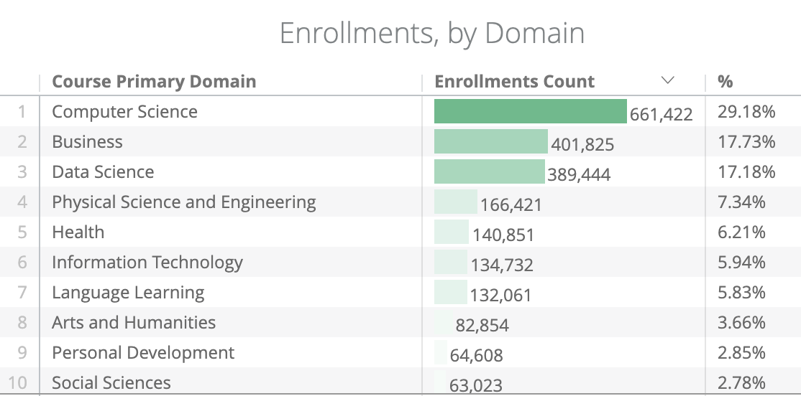
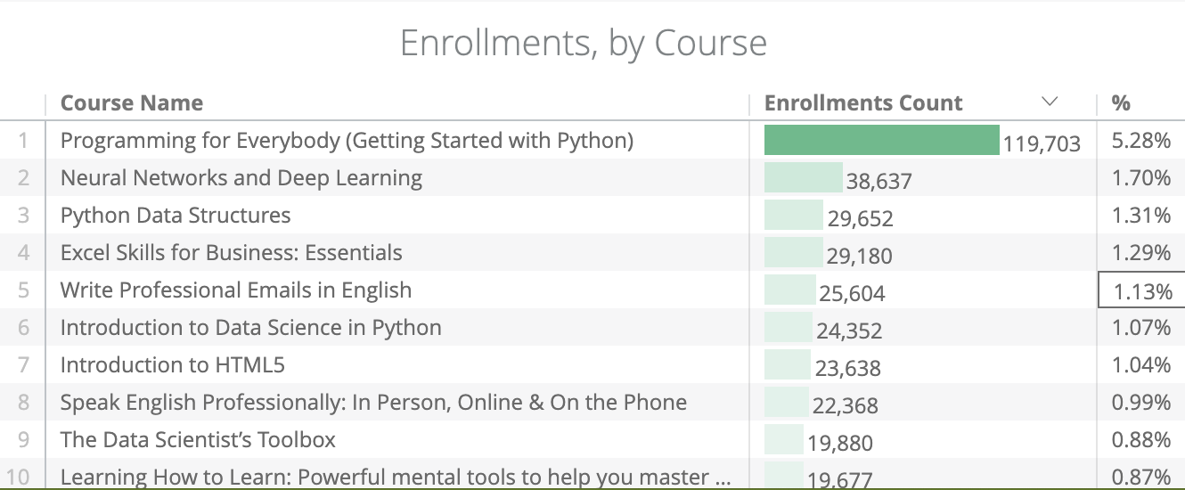
Universities are responding
Since March 12th
34,000+ inquiries by faculty & admin
9,200+ programs launched
1.1 Million students enrolled
4.9 Million course enrollments
58
Source: Coursera data, June 2020
Notes:
What are students learning?
Students are really interested in practical: enrollments are mostly in computer science, DS, and business.
Specific courses are related to jobs, “programming for everybody” has more enrollments than all other courses.
Learning How to Learn, Speaking English Professionally - folks around the globe are using c4c to get job ready
-
Data as of 6/22/20
Universities from all over the world have responding and starting to implement online learning.
Over 34,000 inquiries from faculty and administrators from over 9,200 universities.
And students are taking to it with over 1.1M students enrolled in new courses
These are some the universities that have been responding or using Coursera for Campus
Data last updated on 06.07.2020:
Source for all info: https://docs.google.com/document/d/19aC29xj9oh0wudodMMbMpw0e2Lpp_jTKrPRGluUZMyg/edit?ts=5e5d5668
Source for learners + enrollments: https://looker.dkandu.me/dashboards/1257

Slide 59
Our top Coursera for Campus uses
For-credit learning Build future skills, standalone or blended
Value-added programs Package programs to give students an edge with relevant skills
Faculty/admin training Provide professional development for faculty and staff
Continuing education & workforce development Upskill or reskill graduates to make them job-ready
Job certificate programs Help students jumpstart careers via Professional Certificates & hiring programs
Prerequisite & Summer programs Ensure students show up prepared
Notes:
So how are universities using C4C?
They’re taking open courses and specializations and assigning credit to them. In some cases, they’re creating value added programs to help students with their skills.
Universities are also using Coursera to augment cont. Ed and workforce dev. in their regions. They’re helping students with job certificate programs: the students have a degree, but need professional skills. If they take on a professional certificate, they ….
So that’s C4C, a way to jump into the online world. The message here is that we’re always thinking about careers for our learners. With Coursera, s12ns and certs, we can help learners obtain the careers they are ready for.

Slide 60
Thank you

Slide 61
Discussion & Audience Questions
Gary W. Matkin Ph.D
Dean, Division of Continuing Education
Vice Provost, Division of Career Pathways
University of California, Irvine
Betty Vandenbosch, Ph.D
Chief Content Officer
Coursera
Todd Bloom
Managing Director WGU Labs
Notes:
Gary W. Matkin, Ph.D. is Dean of Continuing Education and Vice Provost for Career Pathways at the University of California, Irvine. The Division of Continuing Education (DCE) offers about 3000 courses per year and attracts about 40,0000 enrollments. It has an annual self-supporting Budget of $40 million. The Division of Career Pathways (DCP) serves UCI’s 36,000 matriculated students as they seek to identify, prepare for, and enter meaningful careers. DCP is expanding its services to continuing education students and alumni as well. DCE is a major contributor to the open education movement and Gary is known for his efforts to support the 60-Year Curriculum and Alternative Digital Credentialing. Gary holds a Bachelor of Science degree from the University of San Francisco, and an MBA and Ph.D. from UC Berkeley and he is a certified public accountant.
Betty Vandenbosch, Ph.D oversees Coursera’s content and credential strategy and partner relationships. Before joining Coursera, Betty was chancellor of Purdue University Global, an institution resulting from Purdue University’s 2018 acquisition of Kaplan University. At Purdue, Betty oversaw academics for more than 32,000 students -- most of whom earned their degrees online. Before that, Betty held a number of leadership positions at Kaplan University and served as associate dean and associate professor at the Weatherhead School of Management at Case Western Reserve University. She earned her Ph.D. in Management Information Systems and MBA from Western University in Ontario, Canada.

Slide 62
Learn More
coursera.org/campus

Slide 63
Appendix

Slide 64
Coursera for Campus Online content and authoring for any college or university
CONTENT
AUTHORING
HANDS-ON LEARNING
SKILLS
EMPLOYABILITY
Access world-class, job-relevant content and credentials from top universities and companies
Allow faculty to create projects and courses for your students for free
Guided Projects help students develop practical skills through applied hands-on projects
Develop job-ready skills
using Essential Skills Maps and skills dashboards
Deliver better student jobs on graduation as well as higher admit rates to Master’s programs
Notes:
Verbally describe the three value props and punch up #3
Offer use case examples for each (especially value prop #1: map to your curriculum for credit, build content into their classes like a textbook , multi-disciplinary learning outside of major) -
Many don’t have faculty to teach A, B, C -- that won’t stop students from learning these concepts

Slide 65
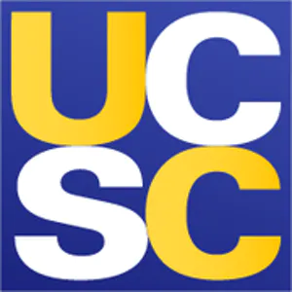
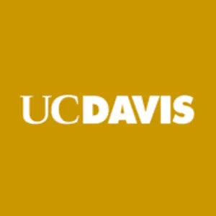
Extensive catalogue of online courses
Business | Technology | Data Science | Health | Social Sciences | Arts & Humanities
1,000+ courses | 700 courses | 380 courses | 100 courses | 780 courses | 340 courses
4,000 courses
140,000 lecture videos
370,000 assessments
Notes:
We have an incredibly valuable catalog of high quality online courses.
These courses span B, T, D, H, SS, A&H. A total of 11 key domains
Our platform hosts 4000 courses with 70K lessons and more than 240K assessments
And more than 600 high quality courses are added to our catalog per year.

Slide 66
Trends in higher education
Online courses and credentials
Online courses and credentials
Blended classrooms
Blended classrooms
Pressure on tuition
Pressure on tuition
Lifelong learning at work
Job-relevant education
Lifelong learning at work
Job-relevant education
Modular and stackable
66
66
Modular and stackable
66
Notes:
Talk Track:
There are other trends that drive the way that the world moves forward. First off, we believe that blended classrooms are here to stay. In some ways, this is no different than a flipped classroom. The lecture is done online and the learning is done face to face or live.
Online courses are also here to stay. Most uni’s, esp. In NA, teach in part online and there are many credentials available online.
These two things lead to downward pressure on tuition - this will go down because people don’t want to pay for the college experience, they want to pay for the skills they need.
That leads us to believe: we need job-relevant education, and we want to pull together theory and practice.
Many institutions are already doing this, but to ensure our learners are job-ready, their education needs to be practical as well as theoretical. They need to understand the concepts and applies them.
It’s important for us to keep track of. Also, we believe (60 year curriculum) lifelong learning, will happen at work. People have busy lives, and once they’re in the workforce they need to be able to learn at the office or on the same day they need something.
So we believe enterprises will get much more involved. Since we’re in a recession in North America, and perhaps the world, enterprises might cut education - but given the dire need for specific skills that aren’t available, learning at work is hear to stay.
PREVIOUS talk track:
Blended will become the new norm.
Both students and teachers will be on/off campus.
That means you must have online content, including courses and fully online degrees.
According to a SimpsonScarborough April 2020 survey, 15% of college students who, when given the option to finish their degree online or complete their degree in-person, want to finish online. As of fall 2019, UNESCO estimates there are 220 million students enrolled in higher ed.
That estimate alone suggests 33 million students could elect to finish their degree online.
Every university will build, buy and augment online content.
Data will make learning more personalized + effective.
Once you start online, there is pressure on tuition
People will not want to pay as much if not on campus.
Also, because of unemployment, people will have less to spend.
With unemployment soaring, job-relevant education will be a must.
According to Gallup, only 34% of US college students feel they have the knowledge and skills needed for the workforce
This will become mission-critical.
Students will demand skill-based, hands-on learning that comes university and industry.
Lifelong learning will happen at work.
People are not going to give up their job to continue learning.
According to Society for Human Resource Management’s 2019 data, more than half (56%) of employers offer tuition assistance for employees pursuing degrees.
Since they’re learning at work, they have to learn in smaller chunks.
Projects; Professional Certificates; MasterTrack™ Certificates
According to a Rapid Learning Institute survey, 94% of Learning & Development professionals said that their learners preferred bite-sized learning modules to eLearning courses.

Slide 67
Continuing Ed is helping students get jobs
Notes:
Talk track: We are partnering with universities and industry to prepare students for the workforce.
UC Irvine has a career specialization that has helped learners build skills they need for the workplace.
This Specialization is a series of open, online courses specifically designed to help learners sharpen the skills that they need to improve employability and advancement.
Courses include:
Project Management: The Basics for Success
Work Smarter: Not Harder: Time Management for Personal & Professional Productivity
Finance for Non-Finance Professionals
Communication in the 21st Century Workplace
High-Impact Business Writing
The Art of Negotiation
Fundamentals of Management
Effective Problem-Solving and Decision-Making
Essentials of Entrepreneurship: Thinking & Action
Career Success Capstone Course
The Specialization concludes with a capstone project and provides you with the opportunity to integrate and apply the skills you have gained to your individual and organizational needs.

Slide 68
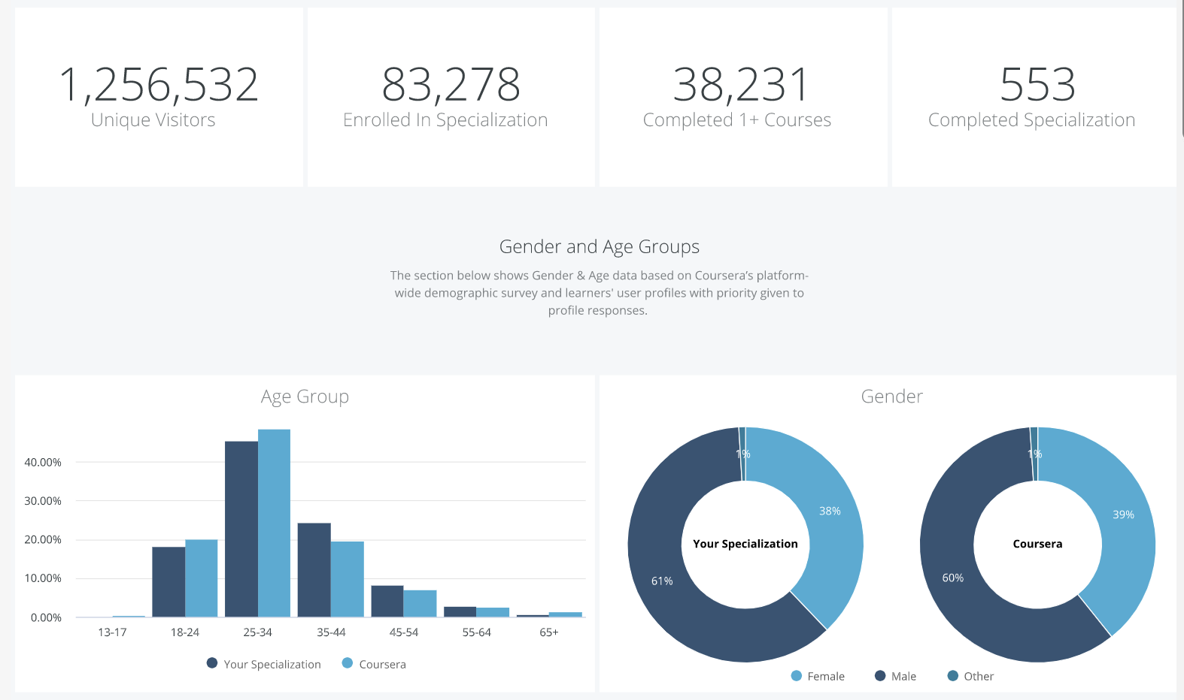
Data from UC Irvine’s Specialization
Notes:
Talk Track:
This specialization has had more than 80,000 enrollments, and over 1.2M visitors to the page, with most falling in the age group 25-34. This has been especially popular in the US, India, Mexico and Brazil. Most students are employed full time and have finished either a bachelor’s or master’s degree.

