Slide 1
How to use diversity, equity, and inclusion in online learning

Slide 2
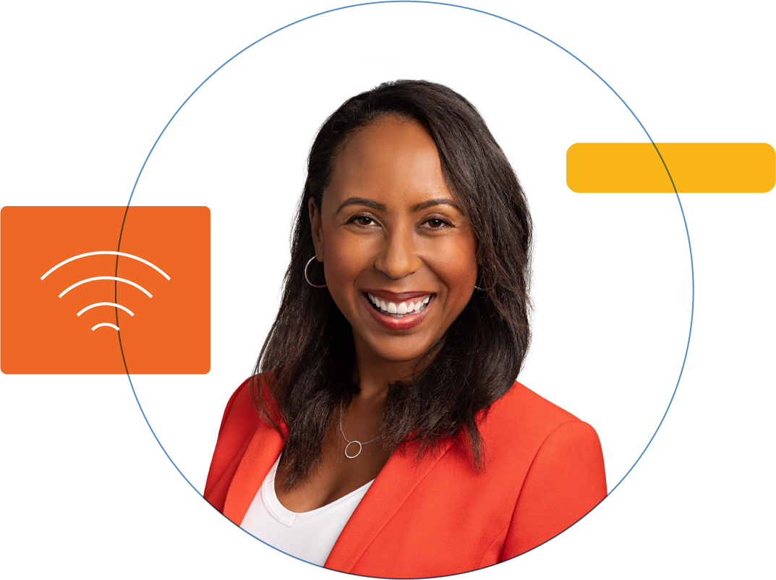
Misty Brown Fischer
@MISTYBROWNFISCHER
Misty has 20 years’ experience in employee engagement, culture development, corporate communications, advertising, PR and digital marketing.
Misty has held global executive roles in advertising, insurance, and higher education. Her efforts in corporate leadership and change management have resulted in award-winning cultures and workspaces, diverse employee populations and engaged communities.

Slide 3
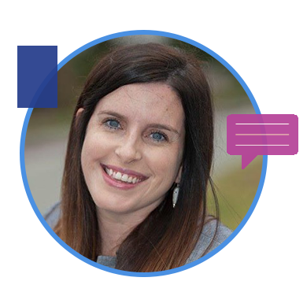
Bethany J. Adams
@BETHANYJADAMS
HR Educator with more than 15 years experience in training, development & organization development. Hosts HR podcast - HR Tea, available on iTunes & Google Podcasts.

Slide 5
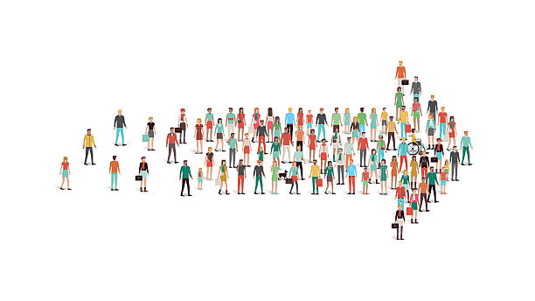
Diversity, Equity, and Inclusion
Misty Brown Fischer, MA, SHRM-SCP

Slide 6
Ideas Can Come From __________ .
Everyone
All
Us
Them
Him
Her
Me
You
Everyone
All
Us
Them
Him
Her
Me
You

Slide 7
Obsessed
with NOT
Just Checking
All the
Boxes

Slide 8
CURIOSITY
CULTURAL
INTELLIGENCE
COGNIZANCE
Inclusive
Leadership
Traits
COLLABORATION
COURAGE
COMMITMENT

Slide 9
BE MODEST. A LOT WAS ACCOMPLISHED BEFORE YOU WERE BORN.
H. JACKSON BROWN JR

Slide 10
Invest in Your People’s
__________ .
Specialness
Interests
Uniqueness
Knowledge
Abilities
Perspectives
Diversity
Individuality
Passion
Specialness
Personalities
Interests
Uniqueness
Knowledge
Abilities
Perspectives
Diversity
Individuality
Passion
Personalities

Slide 11
Misty Brown Fischer MA, SHRM-SCP Chief People Officer https://www.linkedin.com/in/mistybrownfischer/ m.fischer@e-telequote.com

Slide 12
Diversity, Equity, and Inclusion in Online Learning
Bethany J. Adams, MA, SHRM-SCP

Slide 18
Online learning provides an opportunity to reach more diverse learners, but it means we must teach in more equitable & inclusive ways.

Slide 19
Questions
Misty Brown Fischer, MA, SHRM-SCP
Bethany J. Adams, MA, SHRM-SCP

Slide 20
Access the 5-part DEI eBook
Honorlock.com/dei

