Slide 1
Cut Too Deep? Tuition Discounting at a Crossroads
An Inside Higher Ed webcast
Thursday, October 8, 2019
2 p.m. Eastern

Slide 2
Presenters
Rick Seltzer, projects editor, Inside Higher Ed, rick.seltzer@insidehighered.com
Paul Fain, news editor, Inside Higher Ed, paul.fain@insidehighered.com

Slide 3
What is the Tuition Discount Rate?
Financial Aid Dollars Awarded
(Number of Students) x (Sticker Price)

Slide 4
What is the Freshman Tuition Discount Rate?
Financial Aid Dollars Awarded to Freshmen
(Number of Freshmen) x (Sticker Price)

Slide 5

The Discount Rate Doesn’t Matter

Slide 6
Context is Key
How has it changed over time?
How does it compare to competitors’ rates?
What endowment dollars are available?
Who is receiving financial aid?
What is the tuition sticker price?
What effect is discounting having on net revenue?

Slide 7
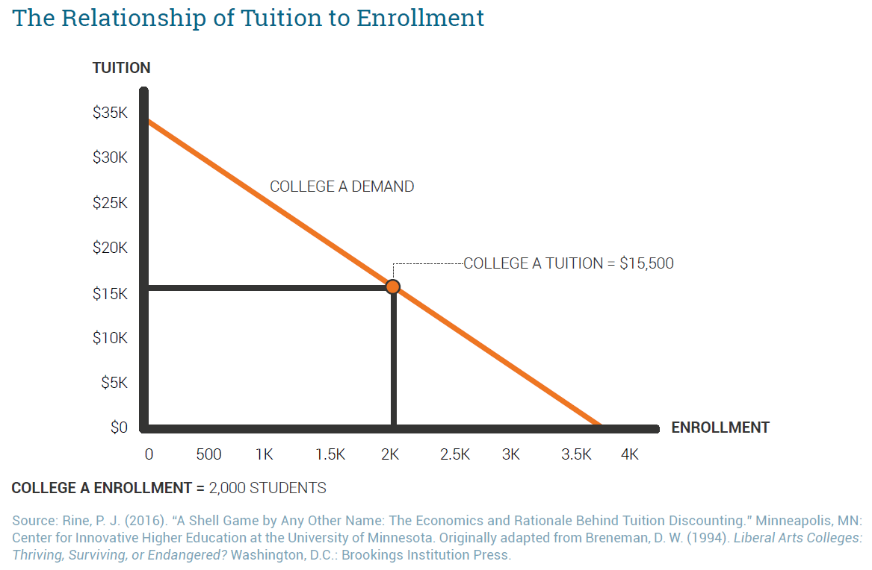
Why Colleges Discount

Slide 8
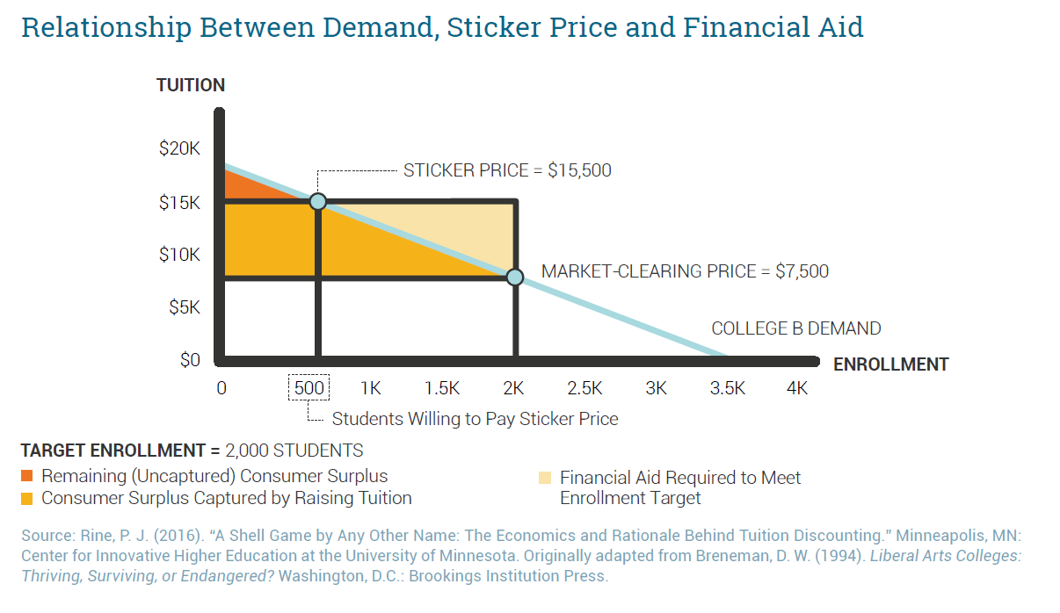
Because it Pays Off

Slide 9
To Build the Classes They Want
Diversity
Academics
Income
Other priorities

Slide 10

Everybody Discounts
Source: Wikimedia Commons/Christopher X Jon Jensen (CXJJensen) & Greg Riestenberg (https://commons.wikimedia.org/wiki/File:Prisoner%27s_Dilemma_icon_(with_words).svg)

Slide 11
Two More Definitions
Funded Aid: Financial aid awarded from a pot of money like an endowment. It results in net tuition revenue.
Unfunded Aid: Financial aid that cuts students’ sticker price without the backing of a pot of money. It marks down sticker prices but doesn’t add net tuition revenue.

Slide 12
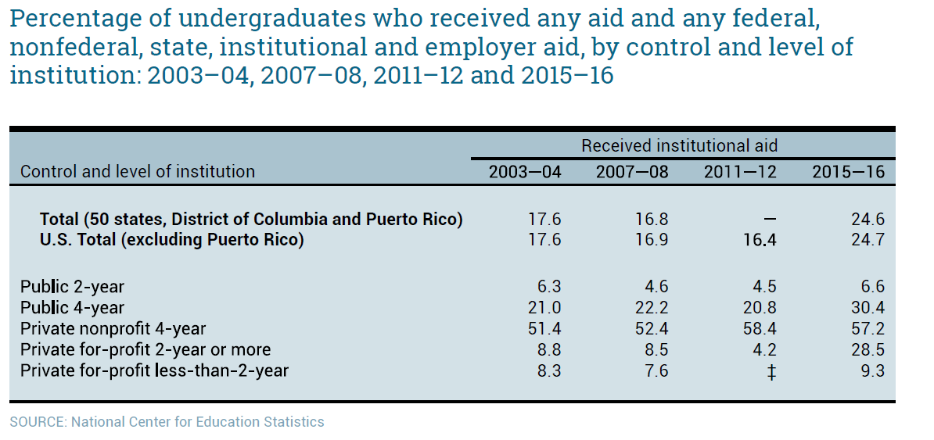
Who Discounts?
Percentage of Undergraduates Who Received Institutional Aid, by Control and Level of Institution

Slide 13
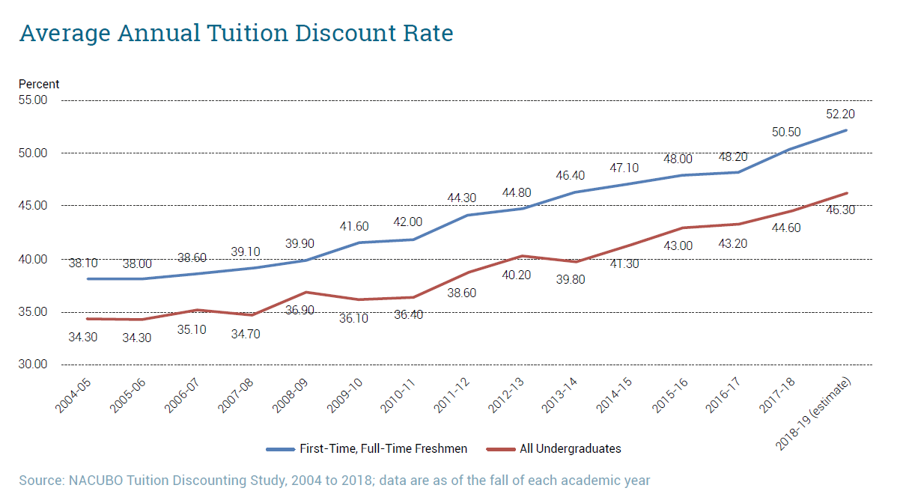
Private Nonprofit Discount Rates

Slide 14
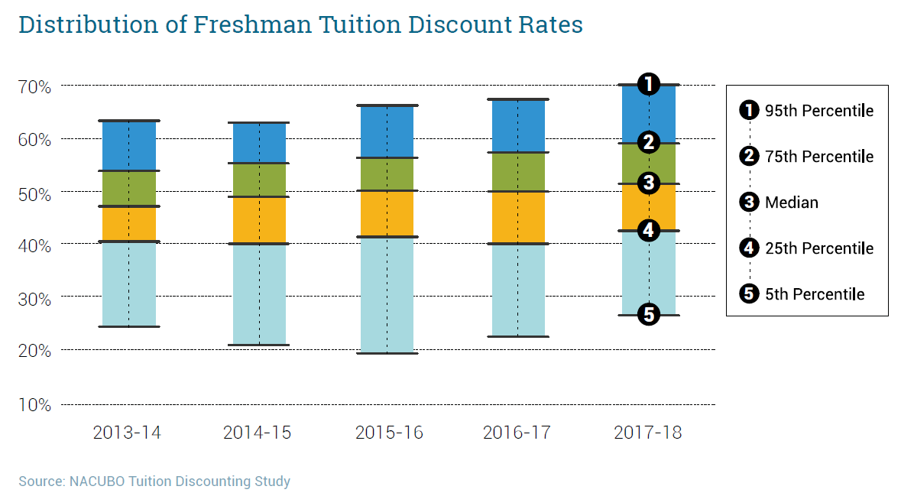
Distribution of Freshman Discount Rates

Slide 15
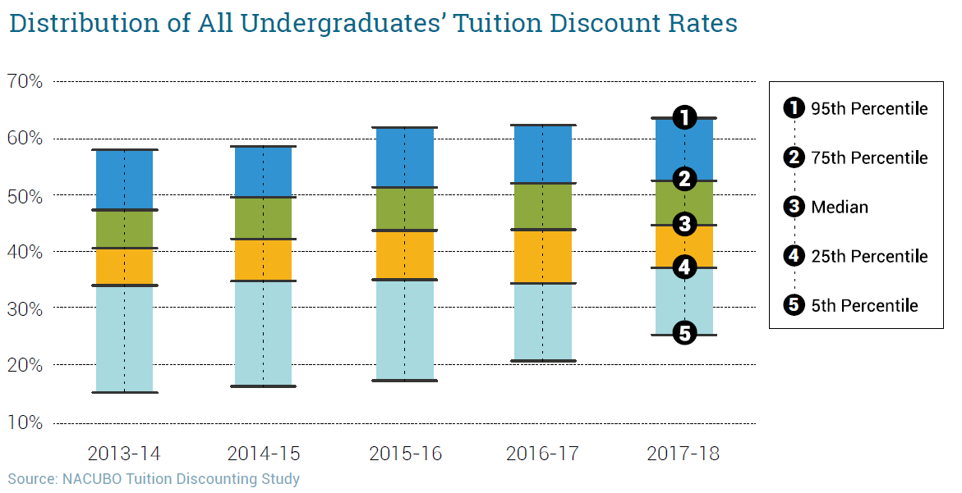
Distribution of All Undergraduates’ Discount Rates

Slide 16
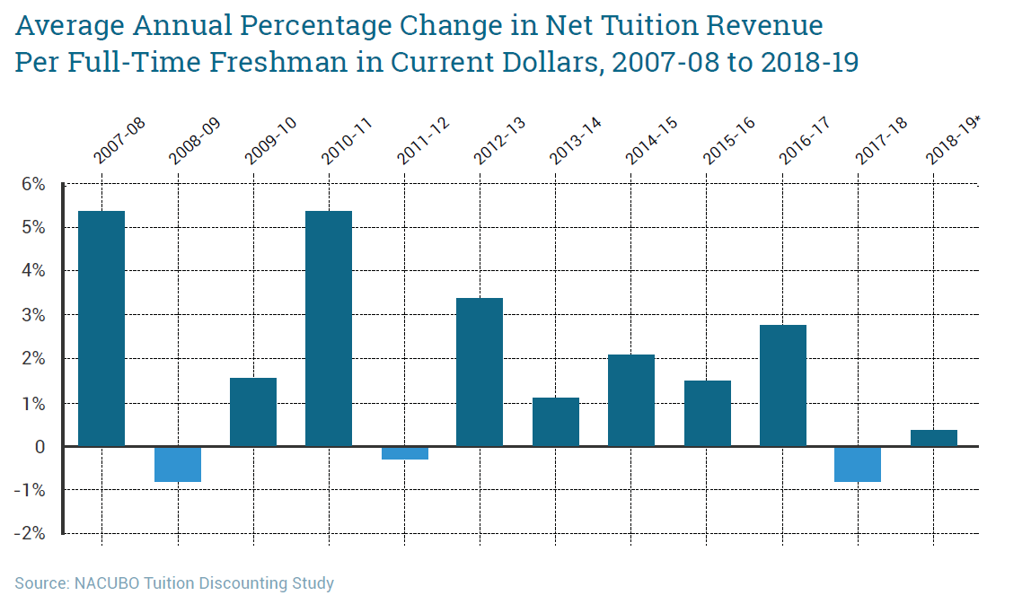
Net Tuition Revenue Struggles

Slide 17
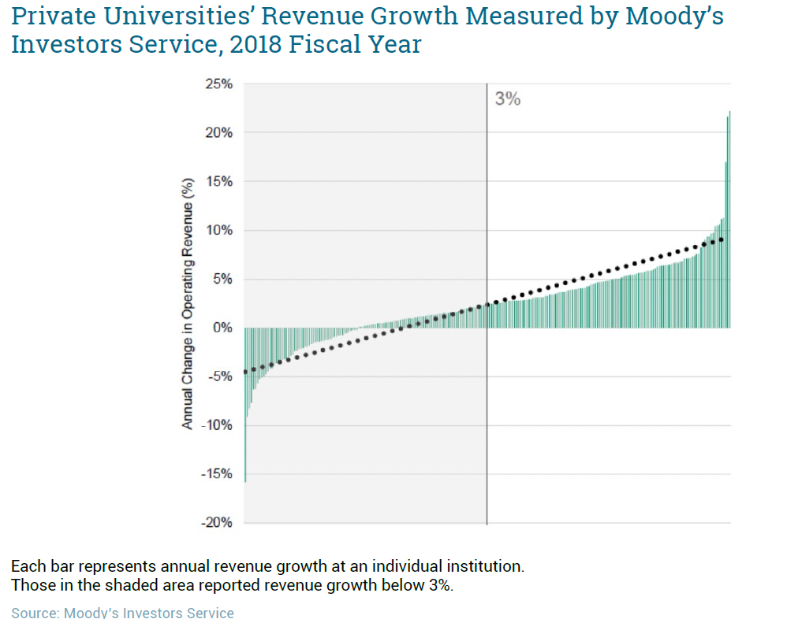
What Does it Mean?

Slide 18
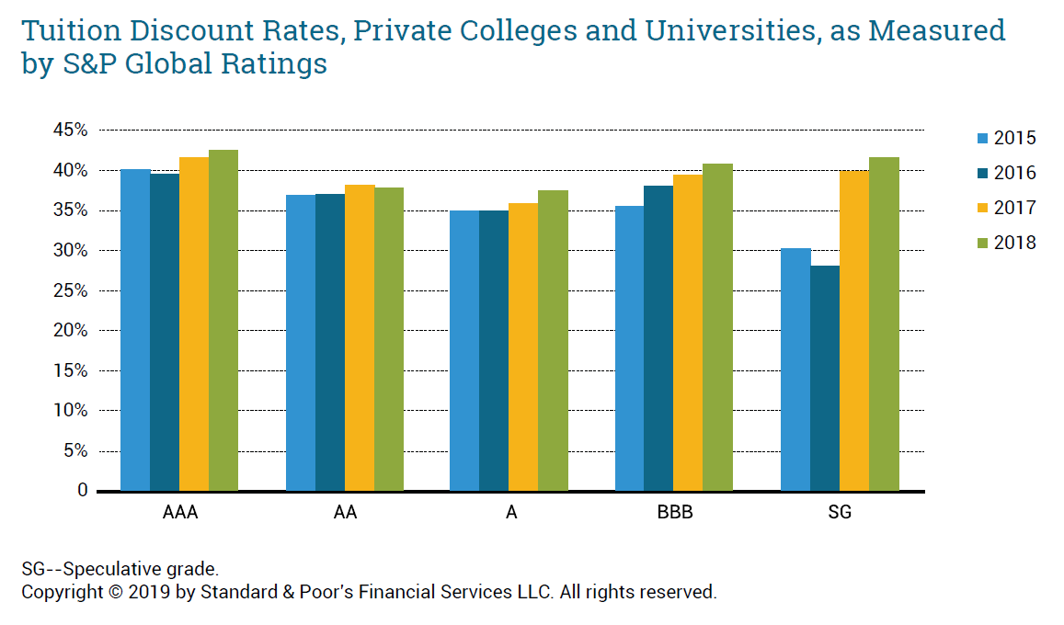
Stress Shows at Weaker Colleges

Slide 19
Public Colleges Discount, Too
RNL on public four-year institutions:
  First-year students’ average discount rate rose 0.8 percentage points to 16.7 percent in 2018.
  Nonresident first-year students received higher discounts than resident students, 23.8 percent versus 14.5 percent.
  Average net tuition and fee revenue for freshmen:
    Resident: $7,001
    Nonresident: $13,115

Slide 20
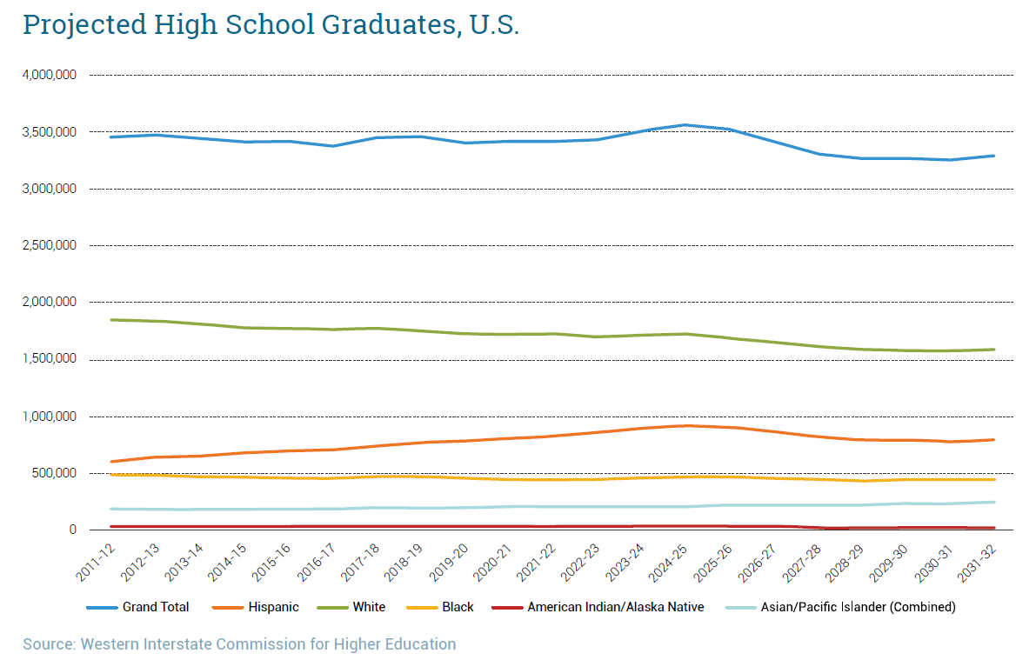
What About the Future?

Slide 21
Problems with Discounting
Public perception
Access and equity
Death spiral?

Slide 22
A Breaking Point?
“It’s a problem with the demand. There are just not that many people who are prepared to pay that net price for what you’re offering.”
-Alex Bloom, consultant, EAB

Slide 23

Searching for a Fix
Tuition resets
Fixed net prices
Net price auctions
More competition

Slide 24
Charting a Course Forward
Consider context
Be smart setting prices
Think strategically
Consider different ideas
Build academic offerings
Manage costs
Remember the students
Trade-offs always exist

Slide 25
A Mature Industry
“These are the margins of retail groceries.”
-Bill Hall, Applied Policy Research Inc.

Slide 26

With Thanks …

