Slide 1
Squeezed From All Sides: Opportunities and Challenges for Regional Public Universities
An Inside Higher Ed webcast
Thursday, August 8, 2019
2 p.m. Eastern

Slide 2
Presenters
Rick Seltzer, senior reporter, Inside Higher Ed, rick.seltzer@insidehighered.com
Doug Lederman, editor, Inside Higher Ed, doug.lederman@insidehighered.com

Slide 3
What are Regional Public Colleges and Universities?
Often defined by what they are not:
Not community colleges
Not flagships or R1 research universities
They are the middle between those poles
Baccalaureate institutions
Teaching focus
Enrollment and program focus on local or regional needs
Public
Revenue from states
Public oversight or board membership

Slide 4
By the Numbers
Graduate roughly 20 percent of all students earning degrees
Graduate almost 40 percent of those earning bachelor’s degrees
Most are not selective in admissions — under 10 percent were ranked as “more selective”
Bulk of enrollment from within 50 miles of campus

Slide 5
Economic Mobility
Source: Wikimedia Commons/Clip Art by Vector Toons

Slide 6
The State of the Regional Public
Stressed
Revenue constraints
Expenses rising
People-heavy operations
Public perception of higher education increasingly negative
Even those that are doing “well” are under certain pressures

Slide 7
State Funding Across the Country
Educational Appropriations
1993-2018
27.8 percent
2008-2018
-4.9 percent
Source: SHEEO SHEF study

Slide 8
Public Institutions’ Tuition Across the Country

Slide 9
Funding Per Student

Slide 10
State Budget Cuts
“Large impacts on attainment at many midtier institutions.”
Source: “The Impact of Price Caps and Spending Cuts on U.S. Postsecondary Attainment.” NBER 2018. David J. Deming and Christopher R. Walters.

Slide 11
Future Enrollment Pools

Slide 12
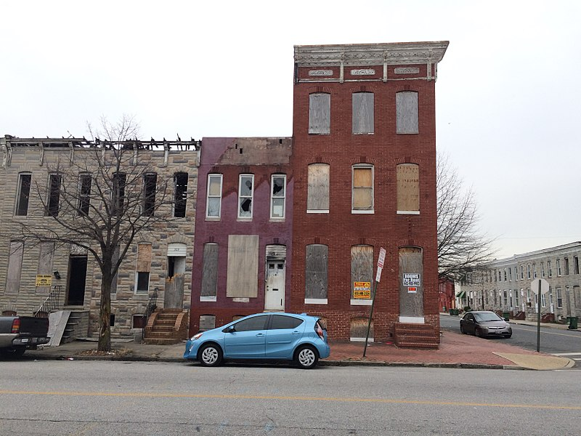
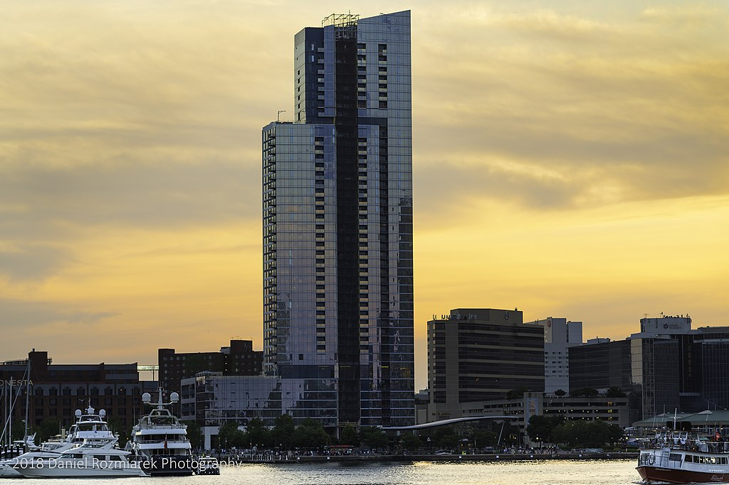
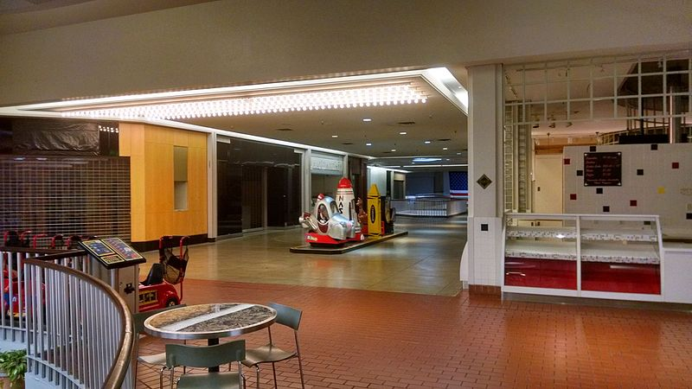
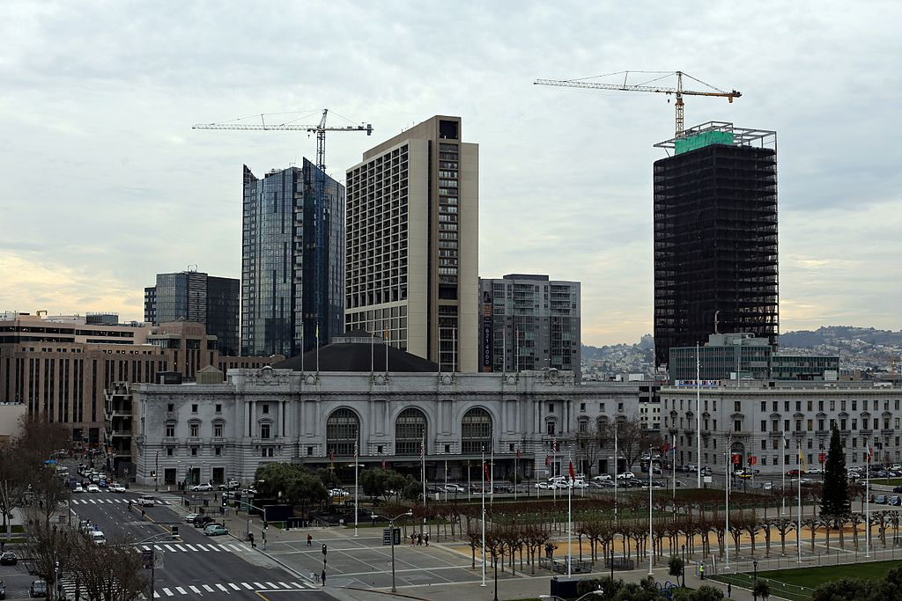
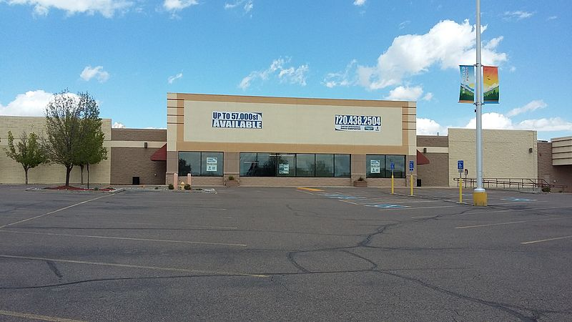
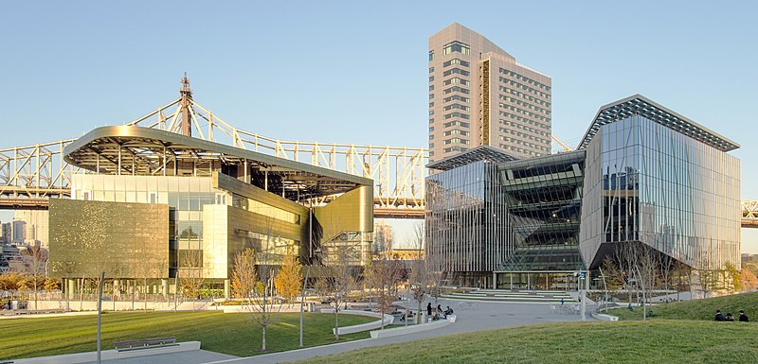
Economic Shifts
Source (clockwise from top left): Wikimedia Commons/Eli Pousson, Danielroz, Basil D Soufi, Rhododendrites cropped by Beyond My Ken, Xnatedawgx, Bellerophon5685

Slide 13
Three Key Themes
Regional public universities must rely on their own creativity
Regional publics must adapt as they find themselves misaligned with local needs
Place matters

Slide 14
Tomorrow’s Regional Public
Focuses on student success
Competes for resources
Builds new structures to meet challenges
Reconsiders systems

Slide 15
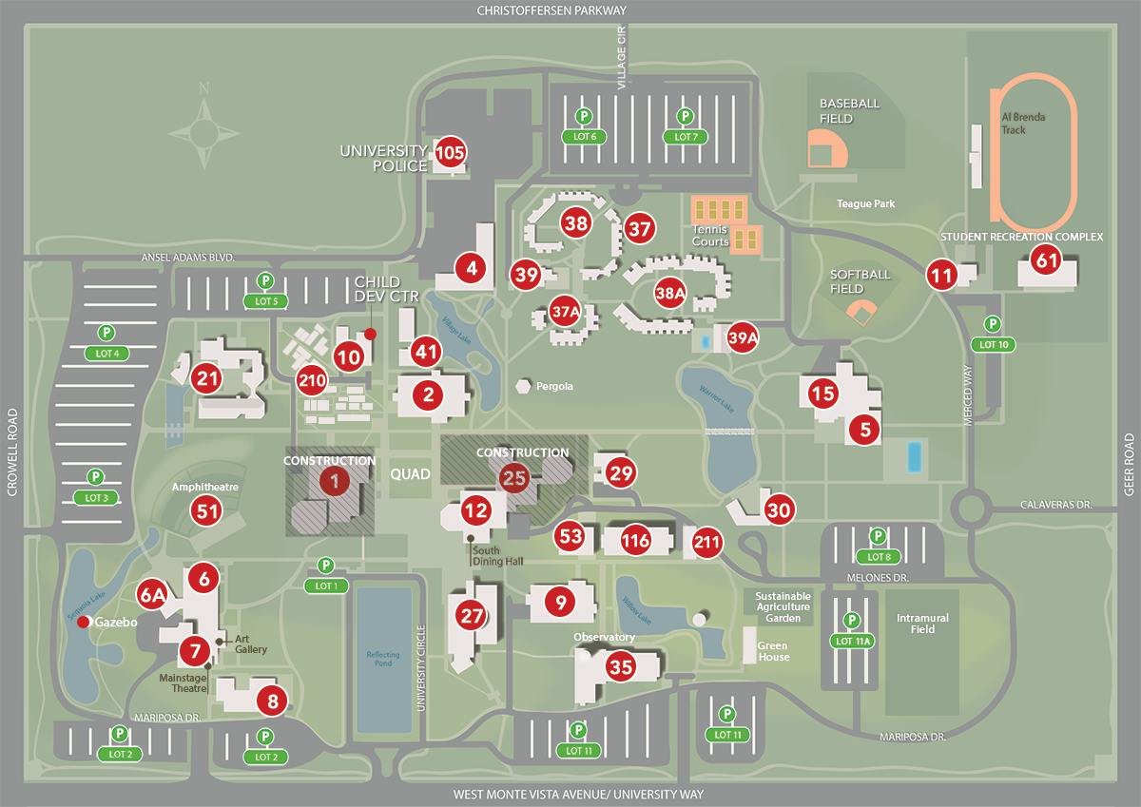
You Have the Blueprint, Right?
Source: California State University, Stanislaus

Slide 16
Risks
Scarcity mindset
Prestige seeking
Mission drift
Inadequate leadership
Labor problems
Inflexible structures

Slide 17
Time to Fold?
Source: Wikimedia Commons/Nintendere

Slide 18
Best Practices
Think local
Engage the faculty
Focus on flexibility
Lobby smarter
Remember the big picture

Slide 19
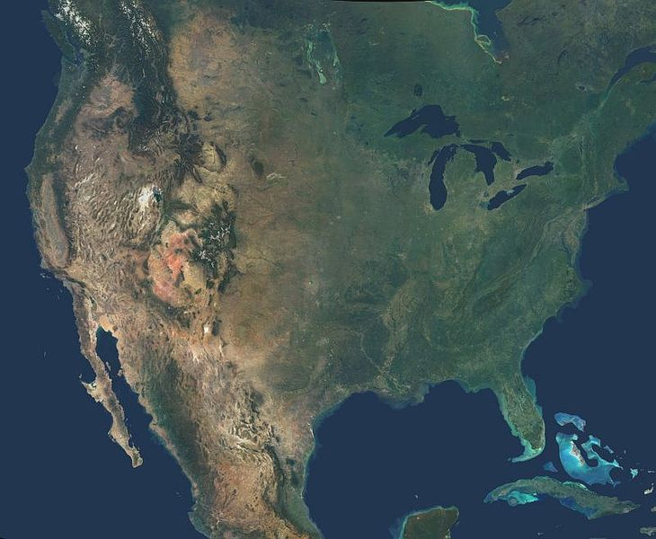
How Will Things Change?
Source: Wikimedia Commons/NASA

Slide 20
Q&A
Your questions
Your ideas for future coverage?

