Slide 1
Recruiting and Retaining Diverse Faculty Members and Administrators
An Inside Higher Ed webcast
Monday, October 26, 2020
2 p.m. Eastern

Slide 2
Presenters
Scott Jaschik, editor, Inside Higher Ed, scott.jaschik@insidehighered.com
Doug Lederman, editor, Inside Higher Ed, doug.lederman@insidehighered.com

Slide 3
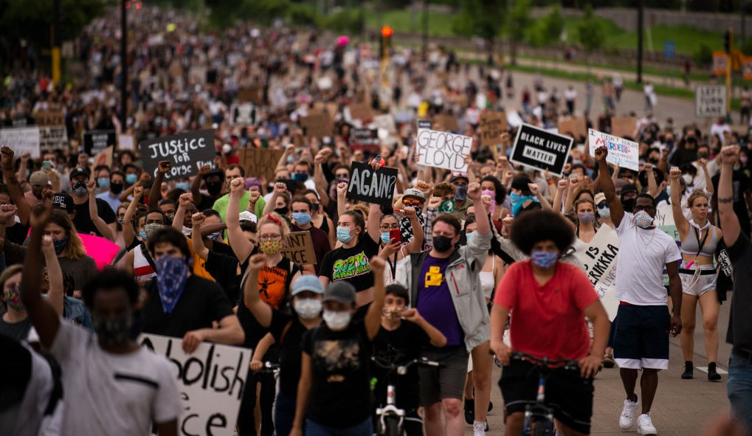
Aftermath of George Floyd Killing
--Getty Images

Slide 4
Why It’s Important
It’s the right thing to do.
Plus…
Students want a diverse faculty and staff.
Lack of diversity can prompt protest.
Foundations and others expect diversity.

Slide 5
Do Colleges Need a Chief Diversity Officer?
--iStock

Slide 6
Why Faculty Diversity Can Be Difficult (But Not Impossible) to Achieve
Hiring is decentralized.
In many cases, the case for diversity must be made department by department.
Fewer Black, Latinx or Native American people earn the Ph.D. than do white or Asian people.
But each of these situations can be solved.

Slide 7
Setting Goals
Why it’s essential.
Why it’s easy to do it the wrong way.

Slide 8
Who Is on Search Committees?
--iStock

Slide 9
Advice for Search Committees (and Those That Track Their Work)
From Abigail J. Stewart and Virginia Valian:
--Define the position in broad terms.
--Provide cues of belonging.
--Search actively.
--Recognize the impact of expressed institutional values.

Slide 10
Benefits of Cluster Hiring
--iStock

Slide 11
Critical Mass
--Getty Images

Slide 12
Salaries
How do you assure fairness?
Should minority faculty be paid more than white faculty?
What is the fair way to judge?
When institutions change reputations, salaries get tricky – irrespective of race.

Slide 13
How Are Administrator Searches Different?
Centralized searches are at least possible.
In certain areas, there are minority candidates.
There is greater flexibility in determining the criteria for eligibility.

Slide 14
A Crucial Problem for (Some of) Higher Ed
College towns have a reputation for being predominantly white.
Urban areas are more diverse.

Slide 15
A Lesson for All
--iStock

Slide 16
With Thanks …

Slide 17
Your Questions

