Slide 1
The Critical Role of General Education
An Inside Higher Ed webinar
Wednesday, May 11 at 2 p.m. Eastern

Slide 2
Presenters
Scott Jaschik, editor, Inside Higher Ed
scott.jaschik@insidehighered.com
Doug Lederman, editor, Inside Higher Ed
doug.lederman@insidehighered.com

Slide 3
What General Education Isn’t (or How It Shouldn’t Be Defined)
Everything that’s not in the major.
Intro survey courses.
What freshmen do.
Requirements to get out of the way.
A checklist.
Humanities.
Education not related to careers.
Why these false definitions matter.

Slide 4
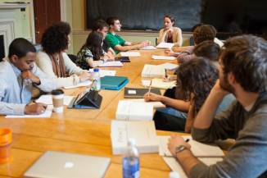
What General Education Can Be (or Should Be)
A guided pathway.
Broad.
Focused on core skills and competencies (not just disciplines).
Based on “high impact” teaching and learning techniques.
The American model.

Slide 5
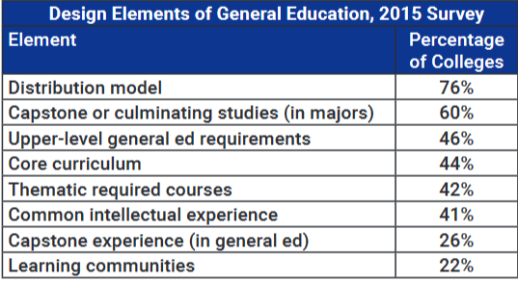
Distribution Plus

Slide 6
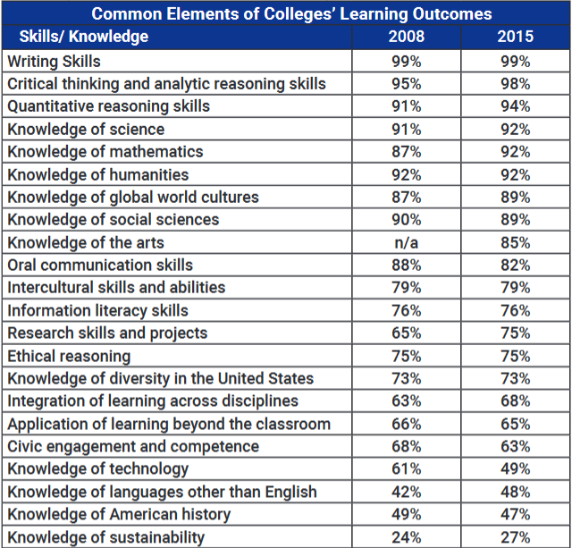
What Students Are Expected to Learn

Slide 7
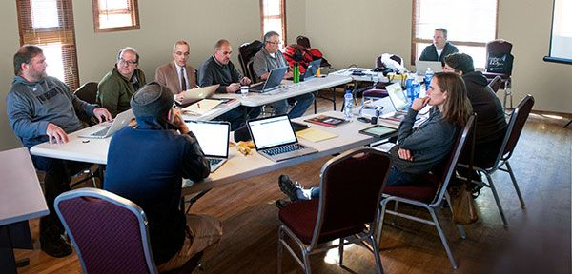
Current Gen Ed Reforms
Harvard University.
Southern Utah.
Duke University.

Slide 8
Diversity and General Education

Slide 9
Computer Science and General Education

Slide 10
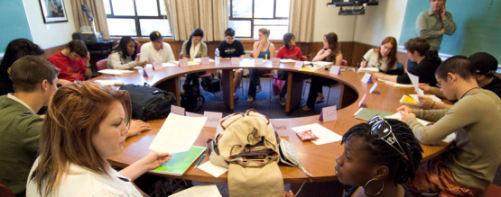
The Faculty Role
Teaching.
Advising.
Moving beyond the course at hand.
Connections with students.

Slide 11
Liberal Arts and General Education
Not identical but related.
Disciplinary roles vs. service to students and the curriculum.
Disappearing disciplines.

Slide 12
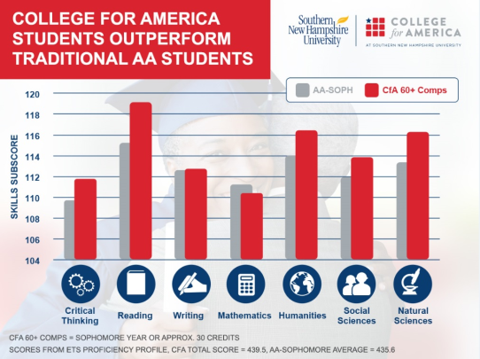
Competency-Based Education and General Education
Why many faculty members worry.
The early data from Southern New Hampshire.

Slide 13
Potential Threats
Vocational emphasis.
Value on speed to degree.
Belief that major is all that matters.
Outsourcing.
Cuts to liberal arts disciplines.
Faculty rewards that favor departmental work.

Slide 14
The Great Lakes Study
Link between general education and career success (as well as happiness).
Potential evidence for a skeptical public.

Slide 15
Your Questions
Q&A.
Suggestions for future coverage.

Slide 16
With Thanks

