Slide 1
Admissions, Retention, Success: Tools Colleges Need
An Inside Higher Ed webcast
Tuesday, November 7
2 p.m. Eastern

Slide 2
Presenters
Scott Jaschik, editor, Inside Higher Ed, scott.jaschik@insidehighered.com
Doug Lederman, editor, Inside Higher Ed, doug.lederman@insidehighered.com

Slide 3
Key Context: Interconnectedness
--Getty Images

Slide 4
Admissions Worries
Filling the class
Balancing priorities
Limited aid (at most institutions)
More demands from some applicants, greater need from others

Slide 5
Early Grades Matter

Slide 6
WPI: Aid Policy and Enrollment Goals

Slide 7
Marquette’s Diversity Strategy

Slide 8
Is Enrollment Management Part of Academic Affairs?

Slide 9
Why Transfer Matters
--Getty Images

Slide 10
Why Transfer Isn’t Working

Slide 11
The Evolution of Remediation
The longstanding criticism
Initial reforms
New round of reforms
Backlash / debate on new round

Slide 12
Sophomore Slumps
The down side of focusing on first-year students and those about to graduate
Significance of sophomore year
Strategies

Slide 13
The Full-Time Strategy
What the research says
Policy implications
Concerns about those who will still enroll part-time

Slide 14
Getting to the Finish Line

Slide 15
Thinking About Careers - I
Can graduates be “robot-proof”?

Slide 16
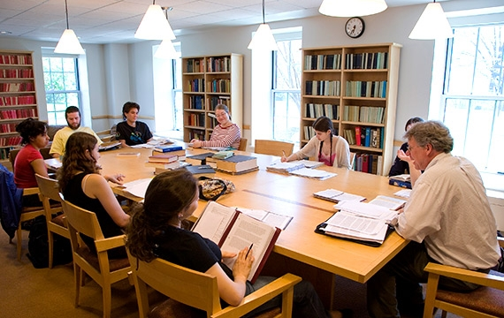
Thinking About Careers - II
The bashing of the liberal arts
Flaws in the critique
New defenses of the liberal arts

Slide 17
Thinking About Careers - III
What if a degree isn’t enough?

Slide 18
Finding the Right Path
--Getty Images

Slide 19
Your Questions
Q&A
Suggestions for future coverage

Slide 20
With Thanks

